Slide 1
What’s that insect?!
Welcome to your very own interactive insect identification key.
This key will help you to determine what kind of insect you have by answering a series of simple questions about how it looks.
Begin

Slide 2
Does it have wings?
Yes
No

Slide 3
Does it have 1 pair of wings or 2 pairs?
1 pair
2 pairs

Slide 4
Does it have a slender, twig-like body?
Yes
No

Slide 5
When folded, do the wings meet in the middle or do they overlap, tent-like?
Meet
Overlap

Slide 6
Is the body flattened from side to side?
SIDE
FRONT
Yes
No

Slide 7
Does the abdomen end in pincer-like parts?
Yes
No

Slide 8
Does it have piercing and sucking mouthparts or chewing mouthparts?
Piercing or Sucking
Chewing

Slide 9
Is the mouth a coiled up proboscis?
Yes
No

Slide 10
Does it have large, special legs adapted for jumping?
Yes
No

Slide 11
Is the back pair of wings fully developed or are they ‘haltere’-like?
Fully developed
Halteres

Slide 12
Are the antennae feathered or clubbed?
Feathered
Clubbed

Slide 13
Are the wings clear or, patterned with small scales or different textures?
Clear
Patterned

Slide 14
Is the body long and slender, or short?
Long
Short

Slide 15
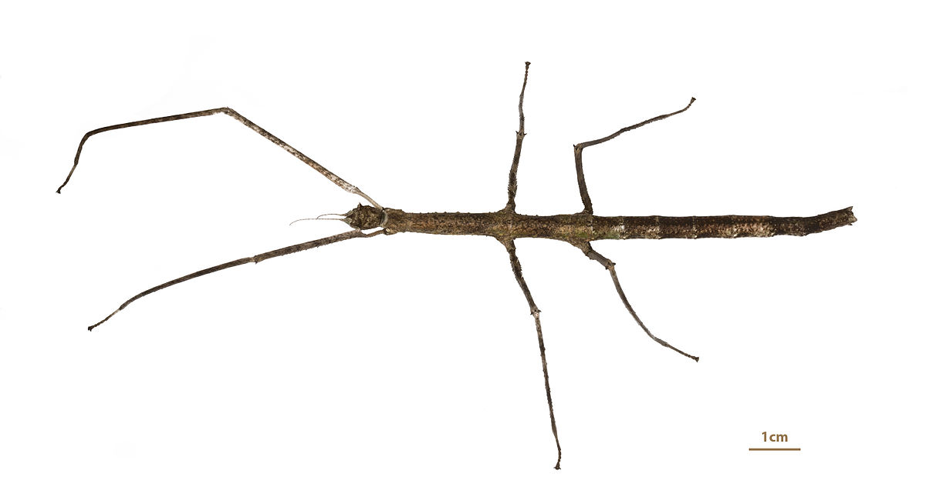
You’ve found a…
Stick insect!
Back to start

Slide 16
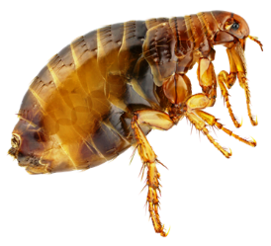
You’ve found…
Fleas or Lice!
Back to start

Slide 17
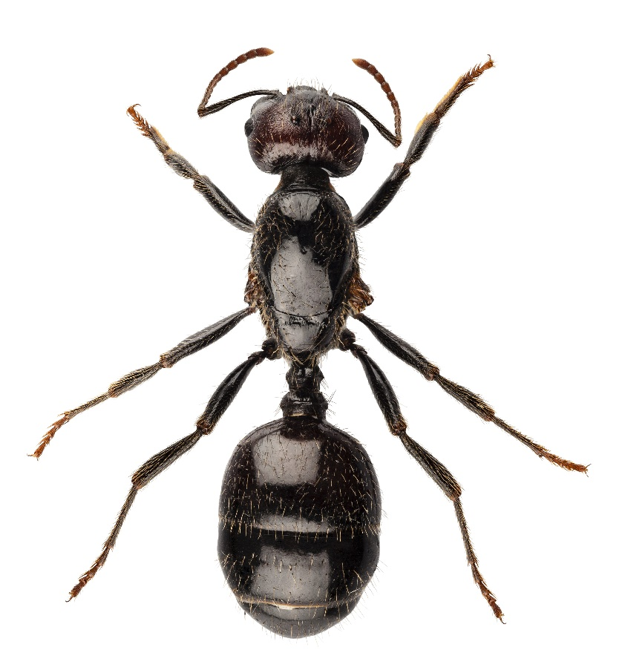
You’ve found an…
Ant!
Back to start

Slide 18
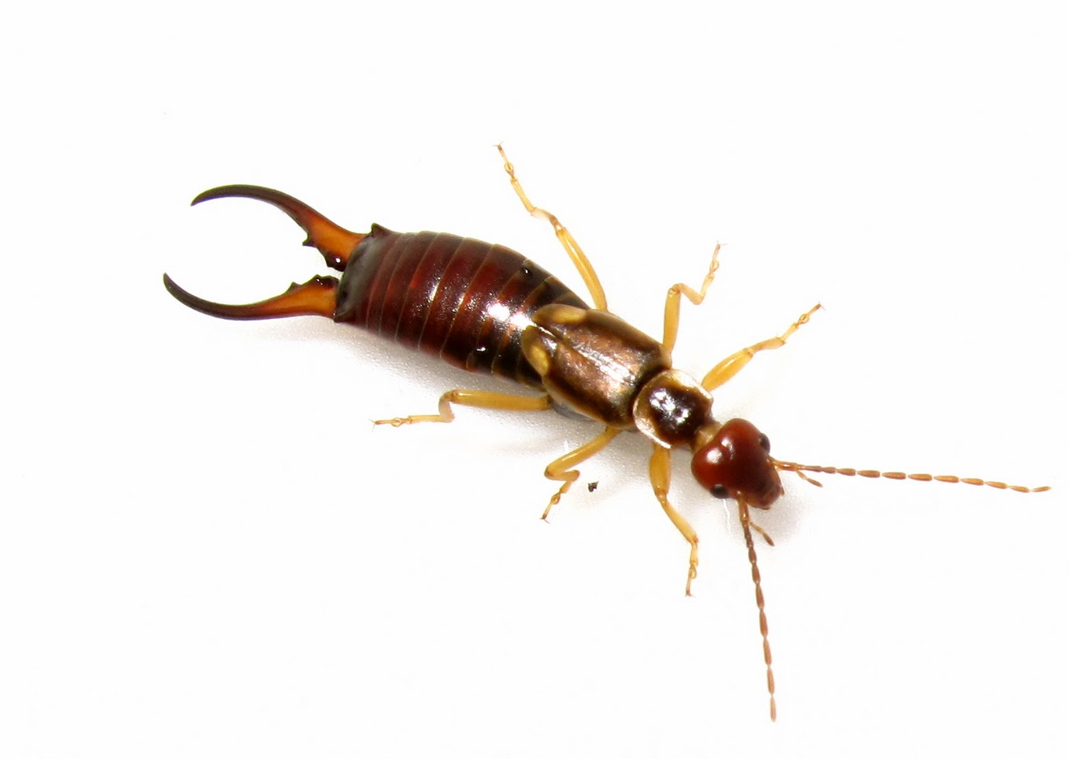
You’ve found an…
Earwig!
Back to start

Slide 19
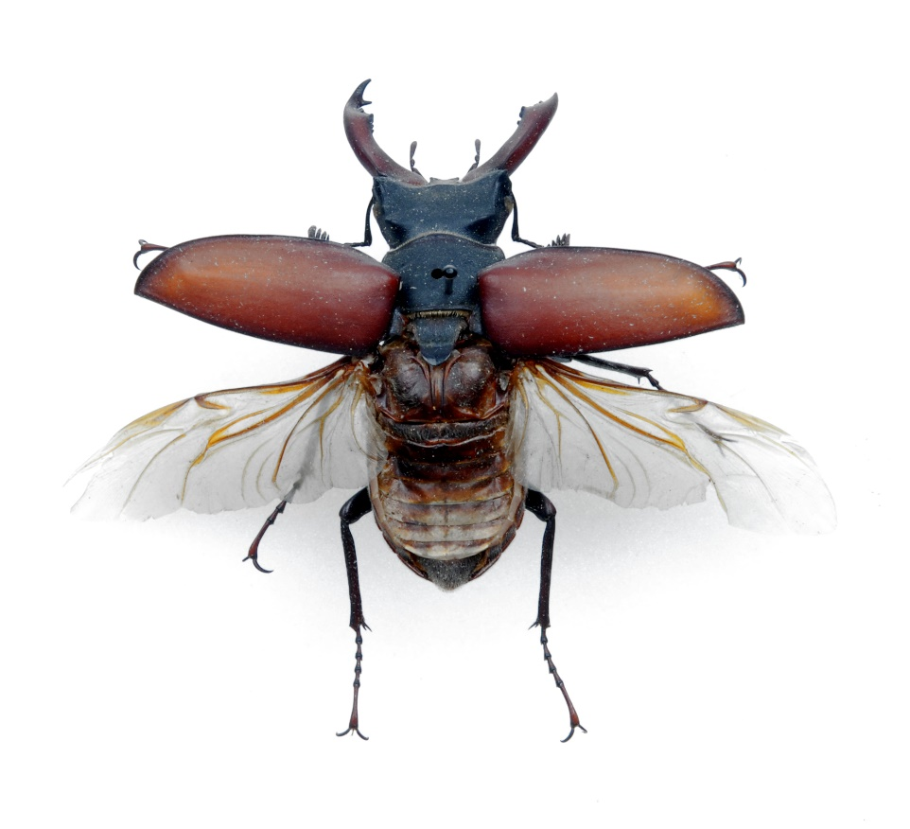
You’ve found a…
Beetle!
Back to start

Slide 20
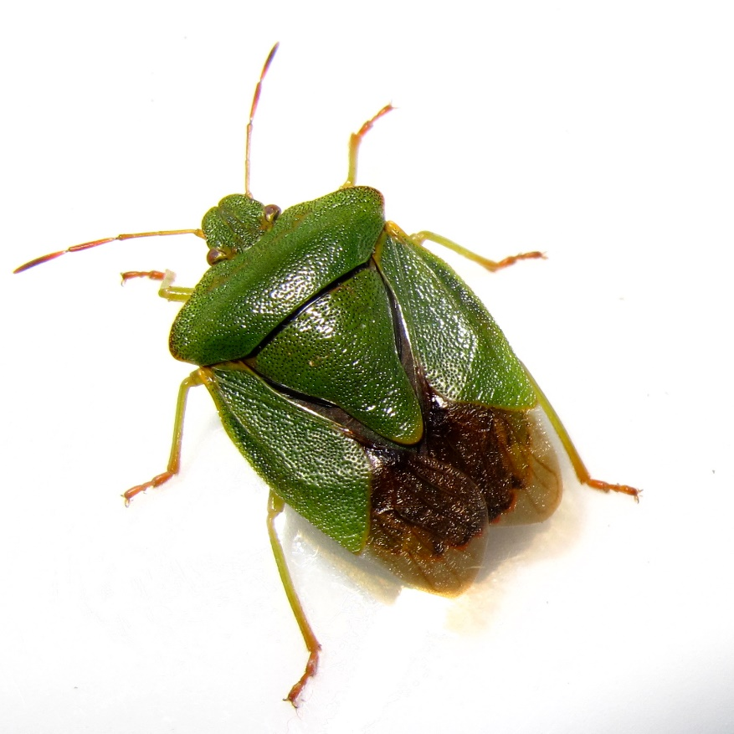
You’ve found a…
True bug!
Back to start

Slide 21
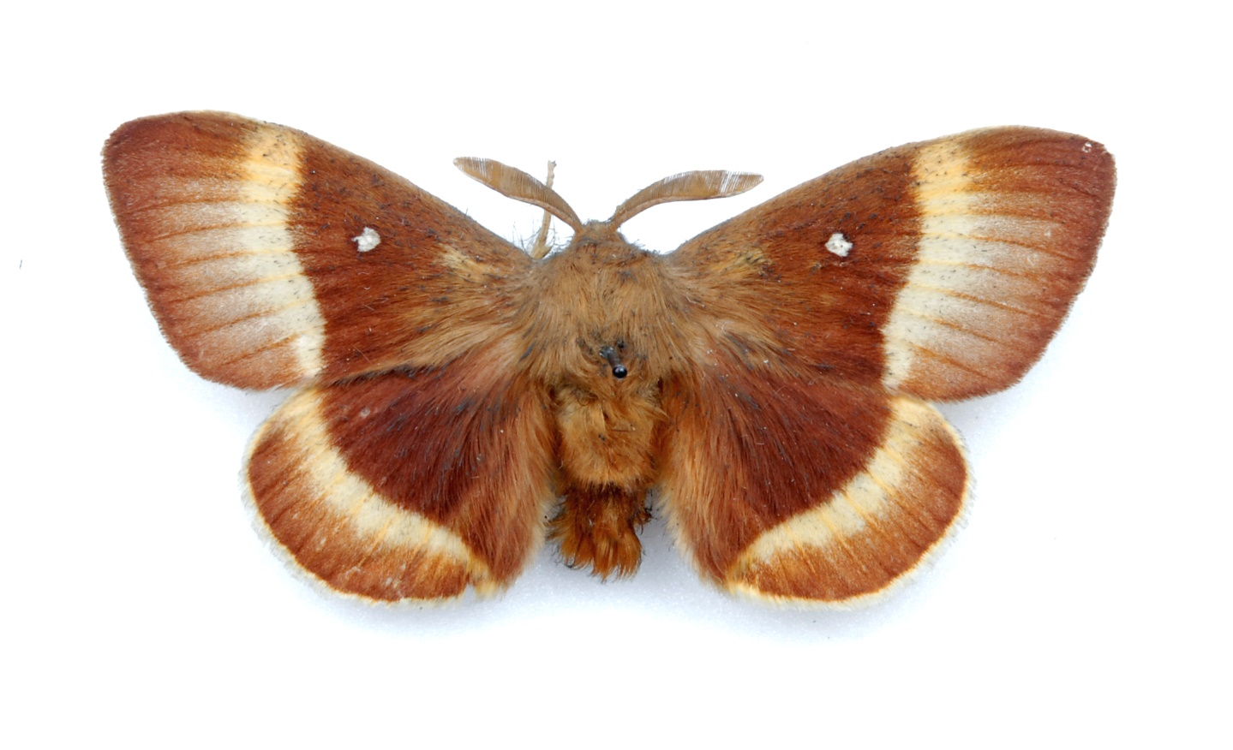
You’ve found a…
Moth!
Back to start

Slide 22
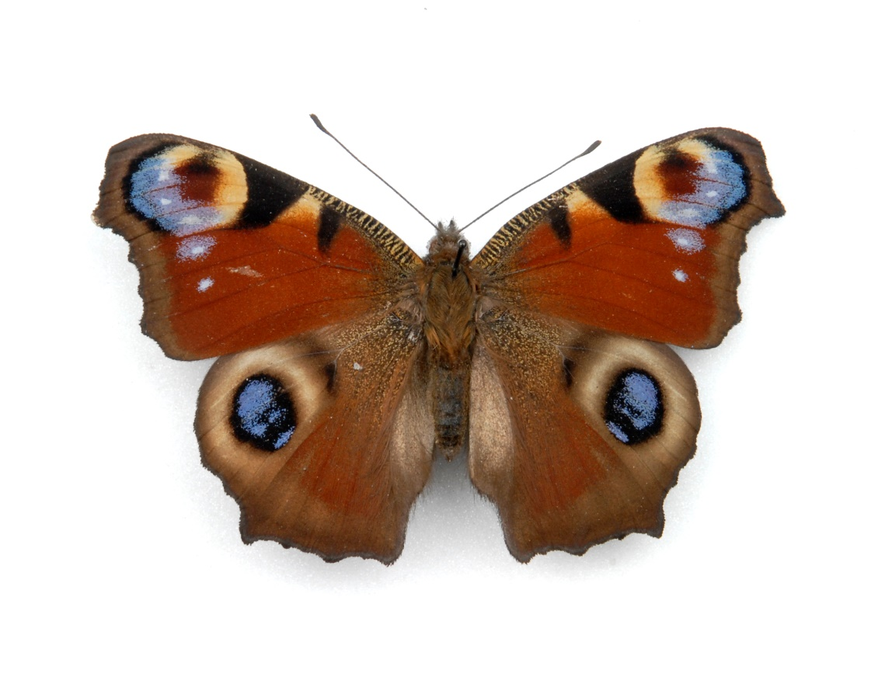
You’ve found a…
Butterfly!
Back to start

Slide 23
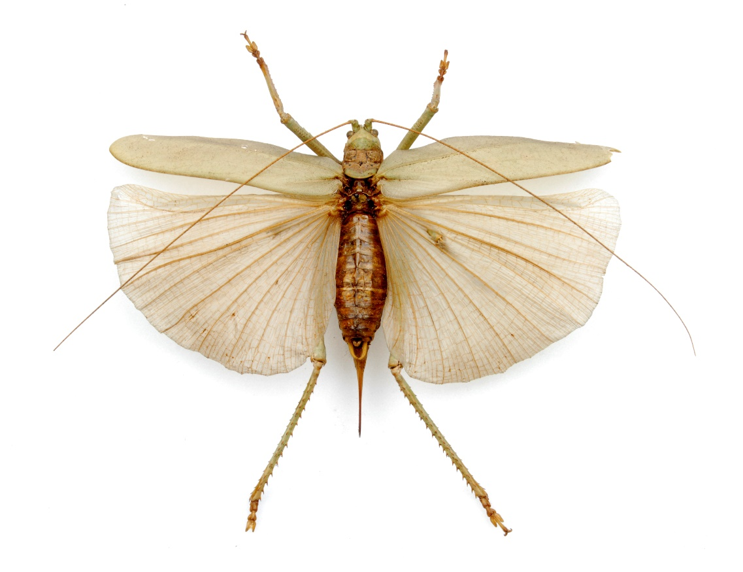
You’ve found a…
Grasshopper!
Back to start

Slide 24
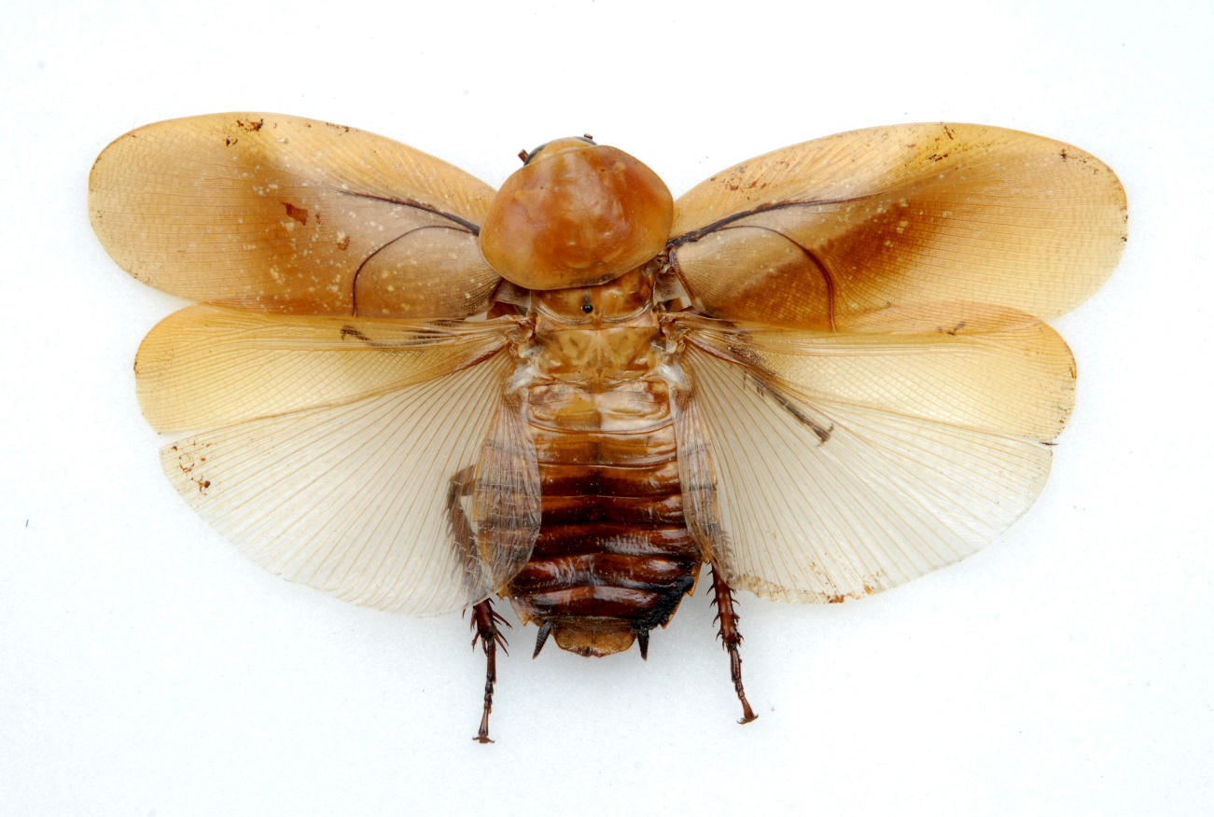
You’ve found a…
Cockroach!
Back to start

Slide 25
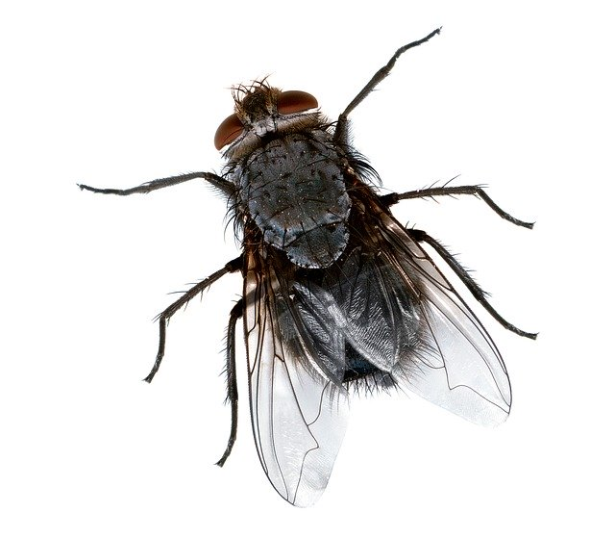
You’ve found a…
Fly!
Back to start

Slide 26
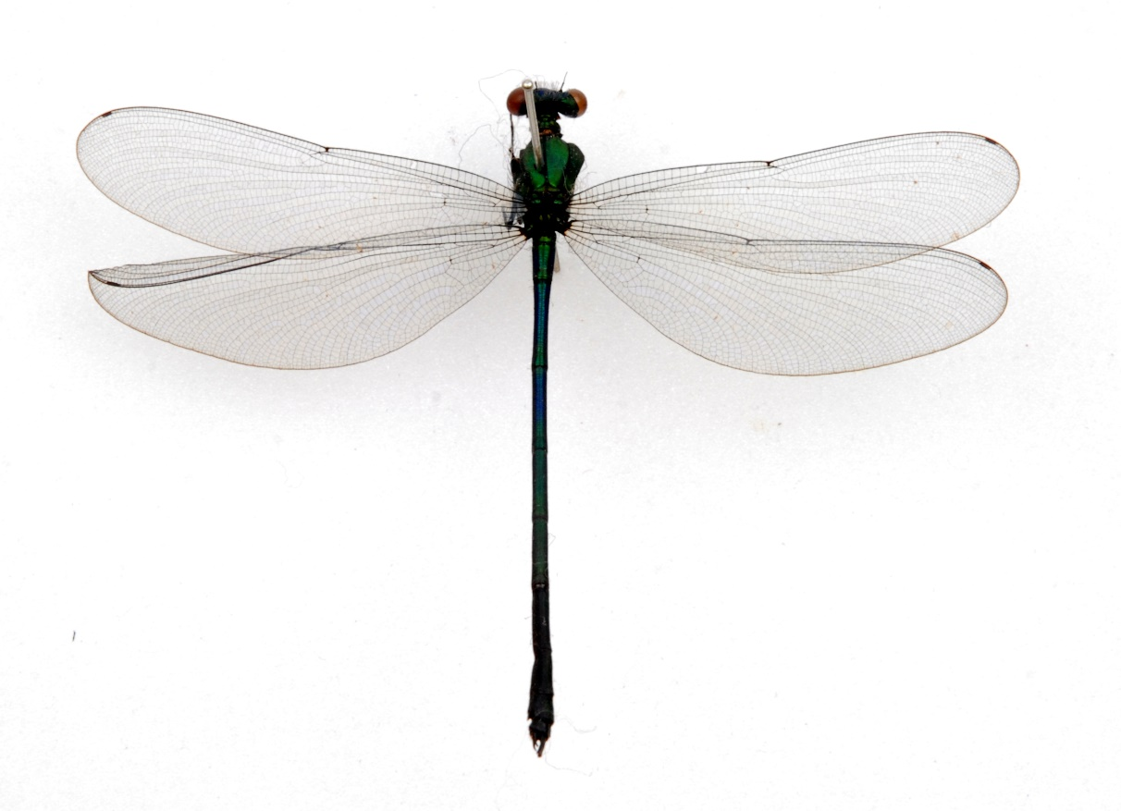
You’ve found a…
Dragonfly or Damselfly!
Back to start

Slide 27
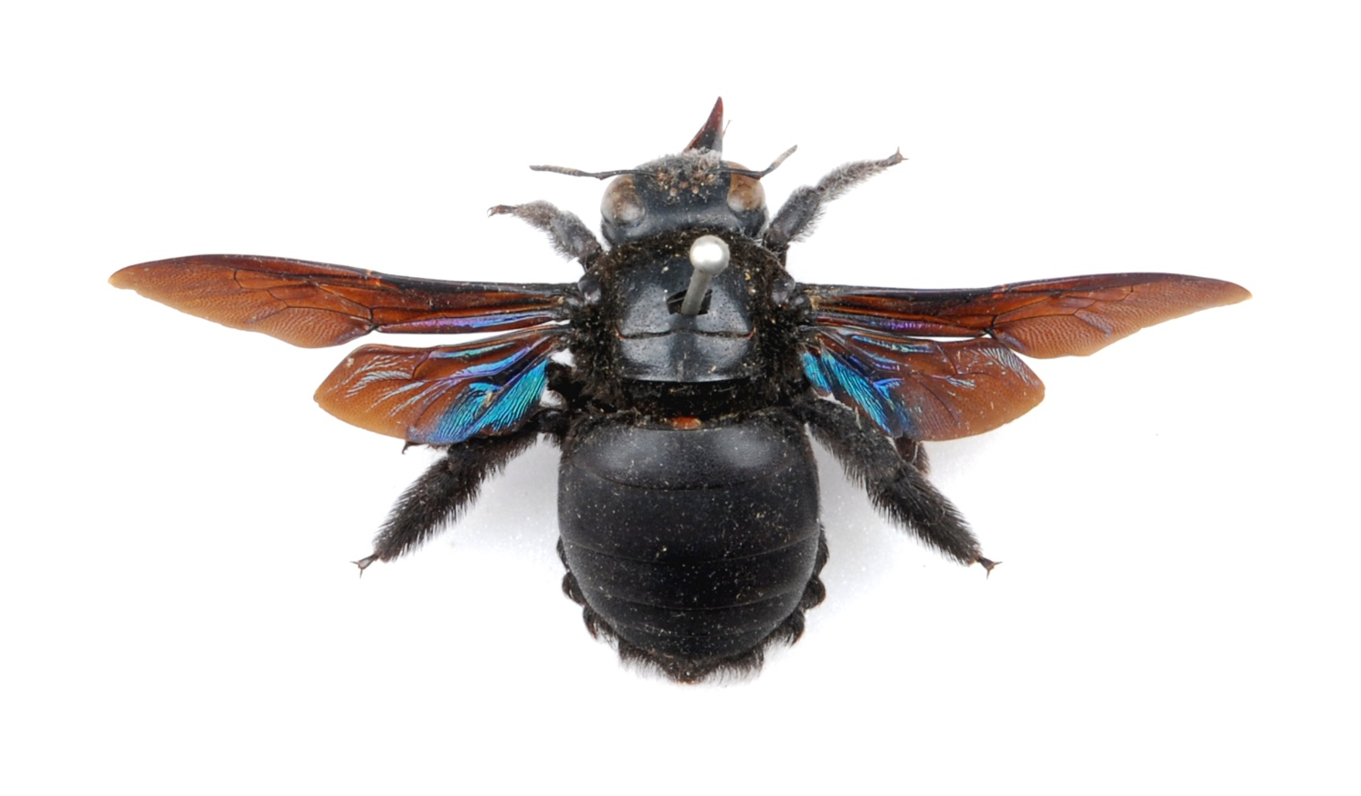
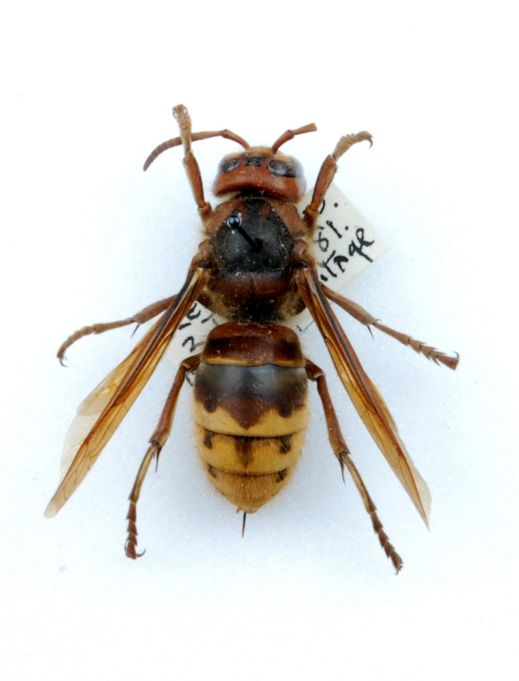
You’ve found a…
Bee or Wasp!
Back to start

