Slide 1
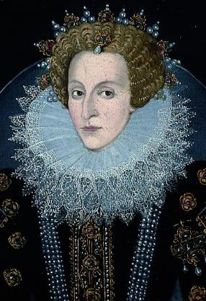
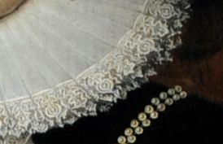
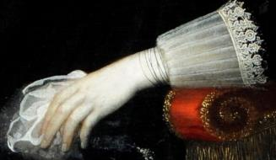
Background information for teachers
The Tudors include famous kings and queens such as Henry VIII and Elizabeth I. They are easily recognised for their fabulous clothes, including the fashion of the Tudor ruff. It was a stiff circular collar that was crimped or pleated into a frill. The pleat or flute of the ruff was called a Purl and these were sometimes edged with fine lace. A ruff was sometimes added to the cuffs of sleeves of clothes too.
Ruffs had no practical purpose, people just wore them to be fashionable and thought that the bigger their ruff, the wealthier it would make them. Sometimes the use of supports such as fine wire mesh and pins were used to keep the larger ruff in place. These were raised at the back of the head.
Maintaining the beautiful appearance of the ruff was hard work. Starch was used to stiffen the fabric. The most elaborate ruffs were made from expensive linen and the finest lace. Lace was then an expensive material, because it had to be imported from Brussels or Italy. The rich Tudors would also have their ruff decorated with gold and silver thread and fine silk. The ruffs belonging to rich women sparkled with decorations.
The next slides provide basic information and step-by-step instructions for pupils to make their own ruff.

Slide 2
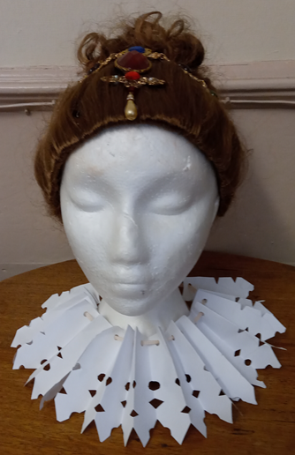
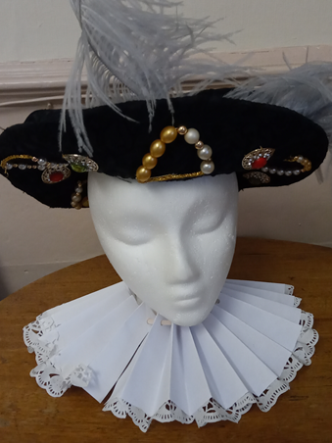
Become a rich Tudor: Make a Tudor ruff
The Tudors are one of the most famous families ever to rule England.
They were in power from 1485—1603.
You can identify people from the Tudor reign from the giant collars they wore called ‘ruffs’.

Slide 3
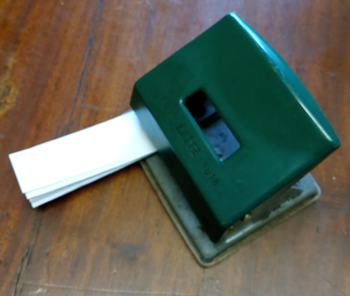
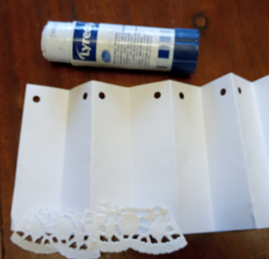
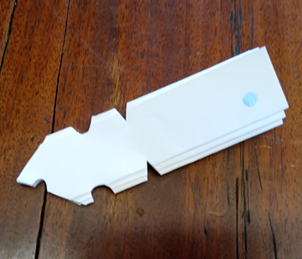
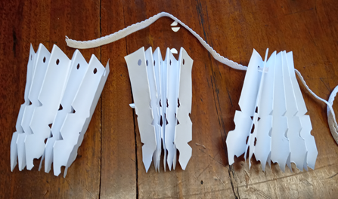
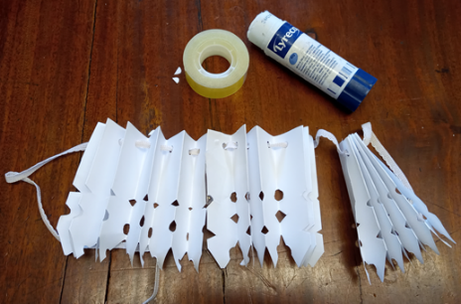
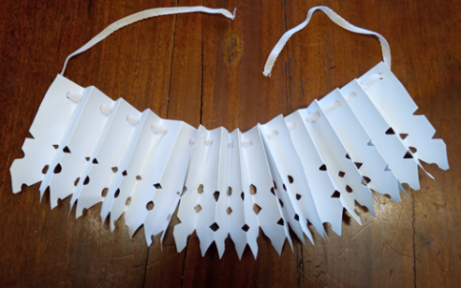
Make a Tudor ruff
1
2
3
Fold 3 strips of paper like a fan, flipping the paper for each fold.
Hole punch each strip at one end.
Open up each strip and glue on ‘lace’ OR cut shapes out of the folded strip.
4
5
6
Thread the ribbon through the holes.
Glue or sellotape the strips together.
Try it on and imagine being a wealthy Tudor!

Slide 4
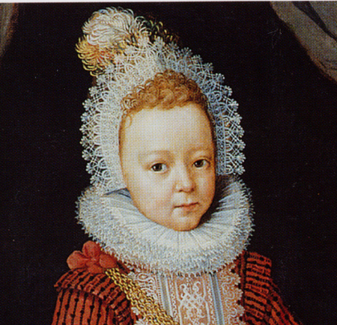
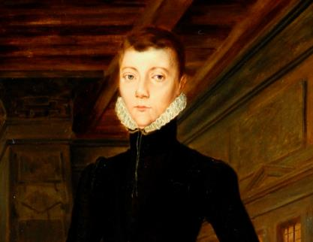
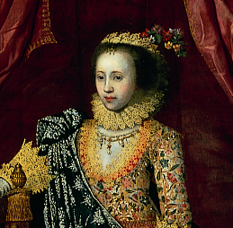
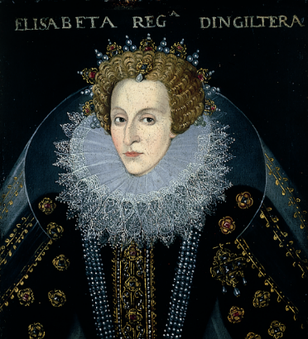
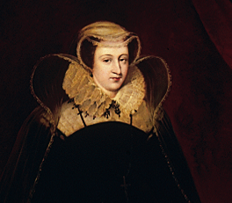
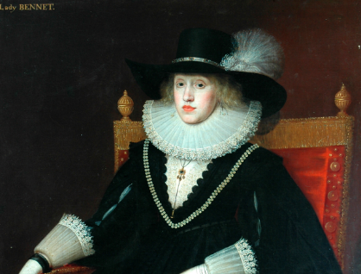
Tudors at Temple Newsam House, Leeds
Lord Darnley
Lord Arendal
Lady Arabella
Mary Queen of Scots
Queen Elizabeth
Lady Bennet
If you were a rich Tudor whose ruff would you choose to wear?

