Slide 1
Mindful Yoga

Slide 2
Why not also try a yoga pose inspired by the object that you’ve just seen…

Slide 3
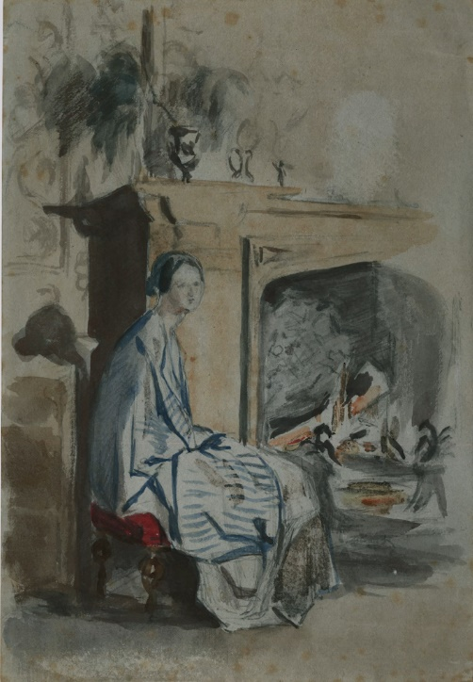
Image © Leeds Museums and Galleries

Slide 4
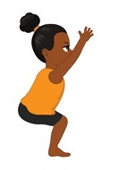
Florence Nightingale We’ve just had a slow look at Florence Nightingale sat on a chair by the fire. Move your arms up above your head as far up to the sky as possible. Then bend your knees slowly and imagine that you are sitting on an invisible chair. Keep pushing your bottom down and keep your arms as straight as possible. You will feel your muscles in your legs after this one but keep going!

Slide 5
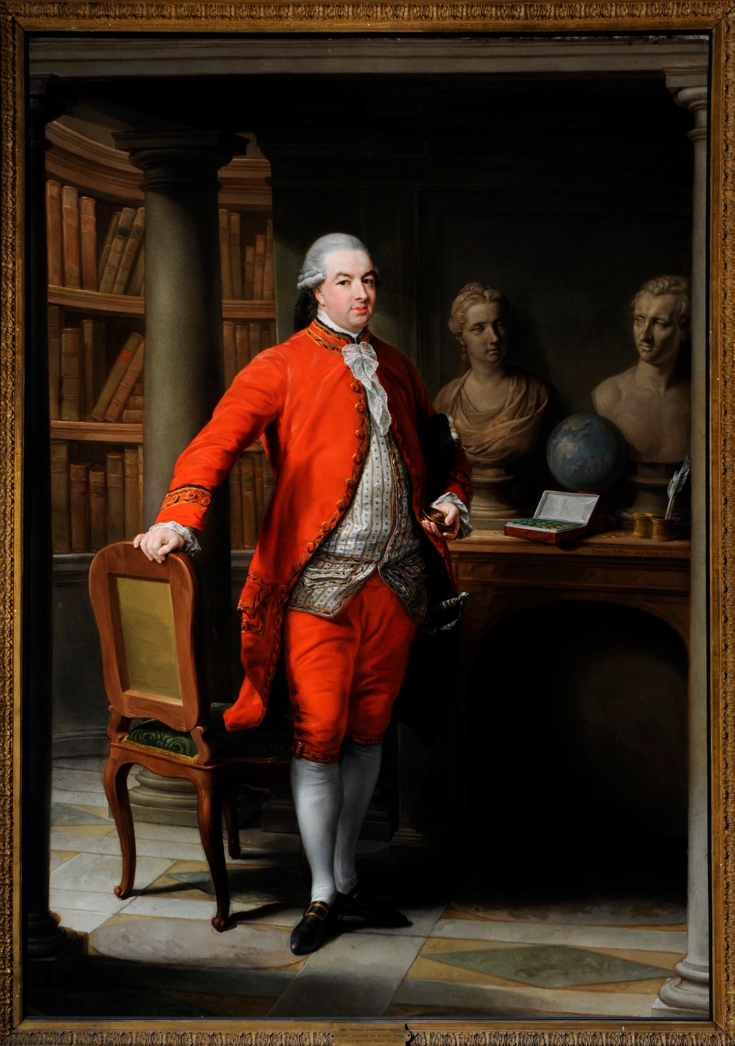
Image © Leeds Museums and Galleries

Slide 6
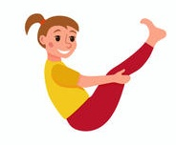
Sir Thomas Gascoigne The painting we just took a slow look at was of Sir Thomas Gascoigne and it was painted just after his ‘Grand Tour’ of Europe. Grand Tours were when rich men went travelling (did you spot the globe?) and to do this many of them travelled by boat. Let’s practice our own boat pose now. Sit down and hug your knees close to you keeping your back straight. Then start to lean back slowly and lift your feet up off the floor. If this feels nice, stretch out your arms straight so that they are next to your legs. Don’t worry if you wobble a bit, looking at your toes can help with this! Hold the pose for as long as feels comfortable and then bring your feet back to the floor.

Slide 7
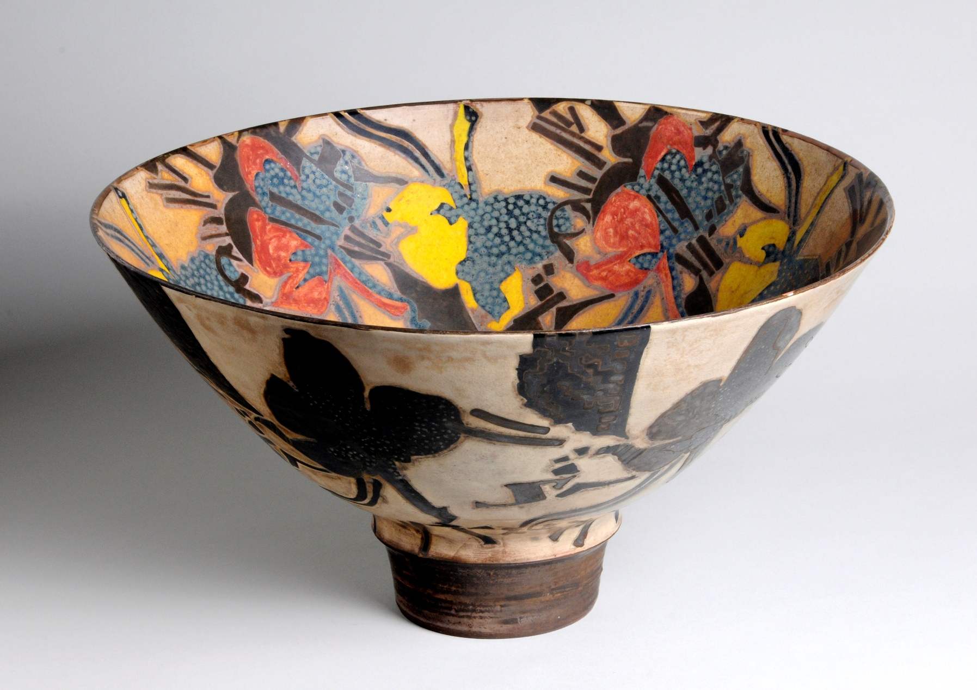
Image © Leeds Museums and Galleries

Slide 8
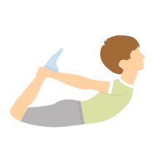
Bowl Lie face down on your tummy with your legs apart. Bend one knee back holding your ankle with the hand on the same side as your bent leg. Then bend the other leg and grab it with your other hand. Take a deep breath and start to lift your head up and pull your legs up towards your bottom. Imagine that you are the bowl that we’ve just taken a slow look at and that you are trying to hold some water in the bowl you’ve made with your back! Keep breathing in and out and then slowly let go of your feet and go back to laying flat on your tummy.

Slide 9
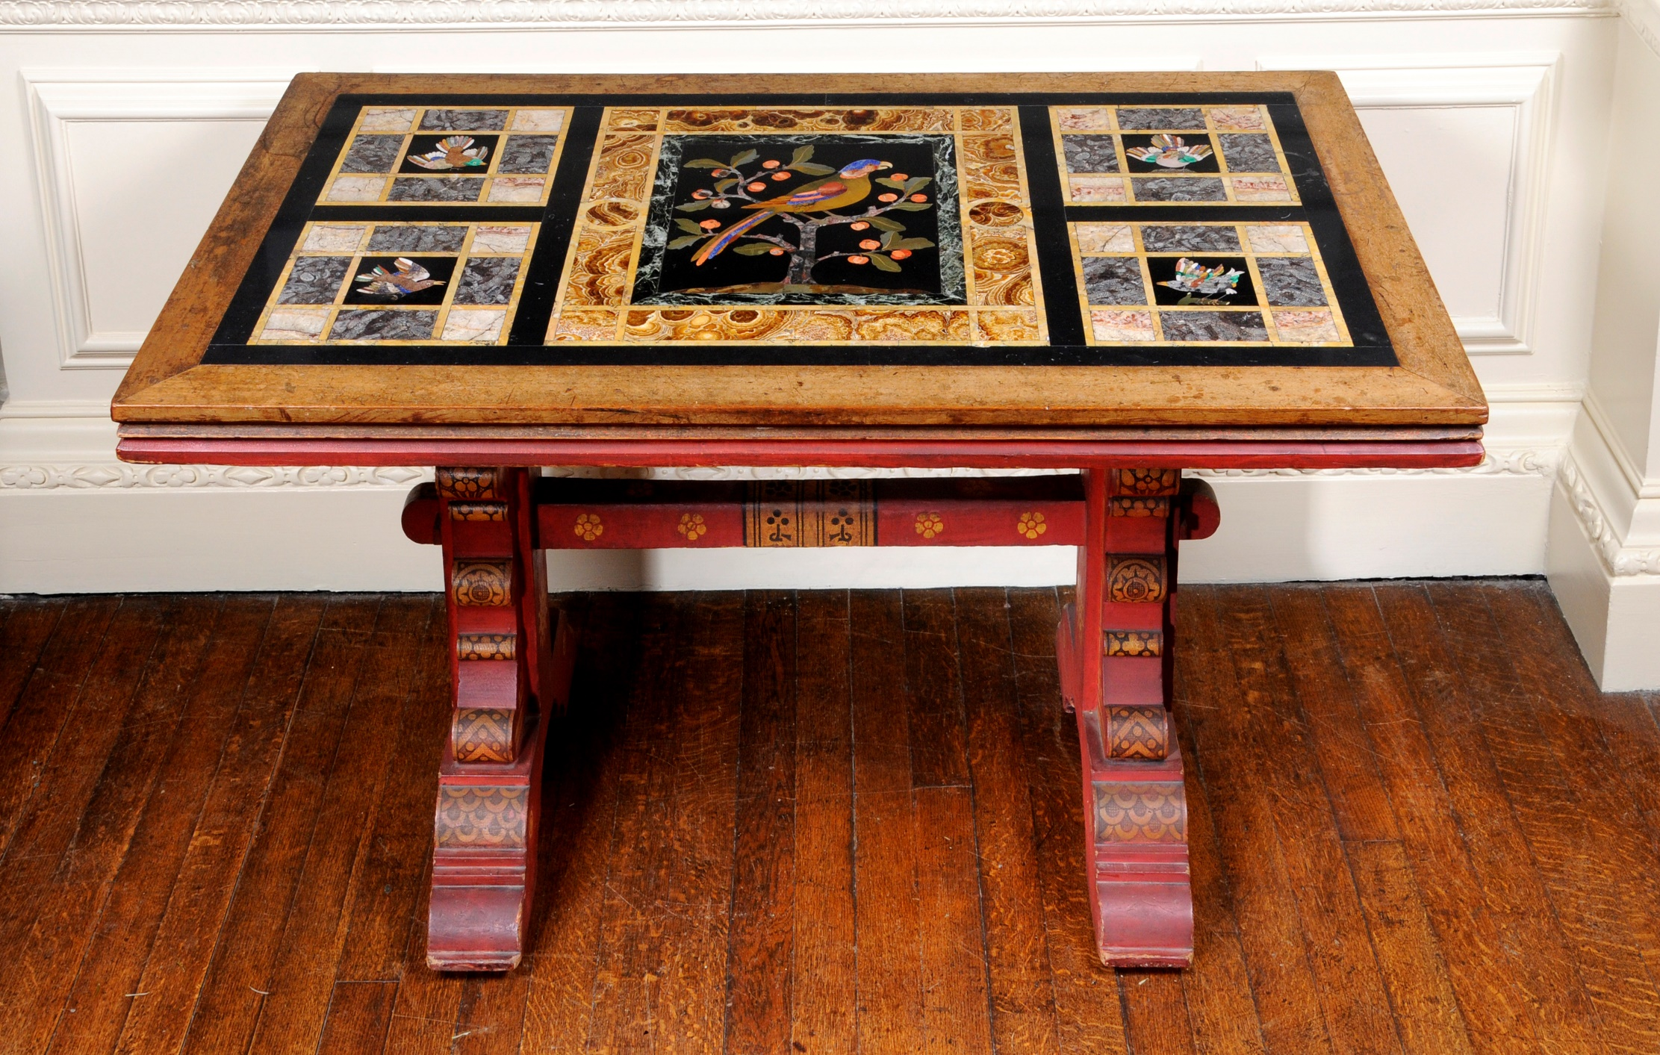
Image © Leeds Museums and Galleries

Slide 10
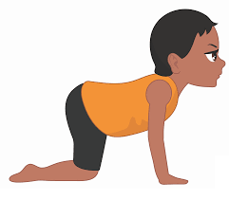
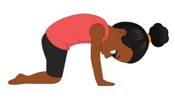
Table Let’s be strong and stable like the table we’ve just taken a slow look at. Start with your knees on the mat under your hips and your arms straight underneath your shoulders. Try to keep your back as straight as possible. Now imagine that something heavy has been placed on your table (your back) and allow your back to dip down towards the floor and feel it curve. Then remove the heavy object and curve your back up towards the sky. Breathe in as the heavy object goes onto your table and breathe out as it is removed.

Slide 11
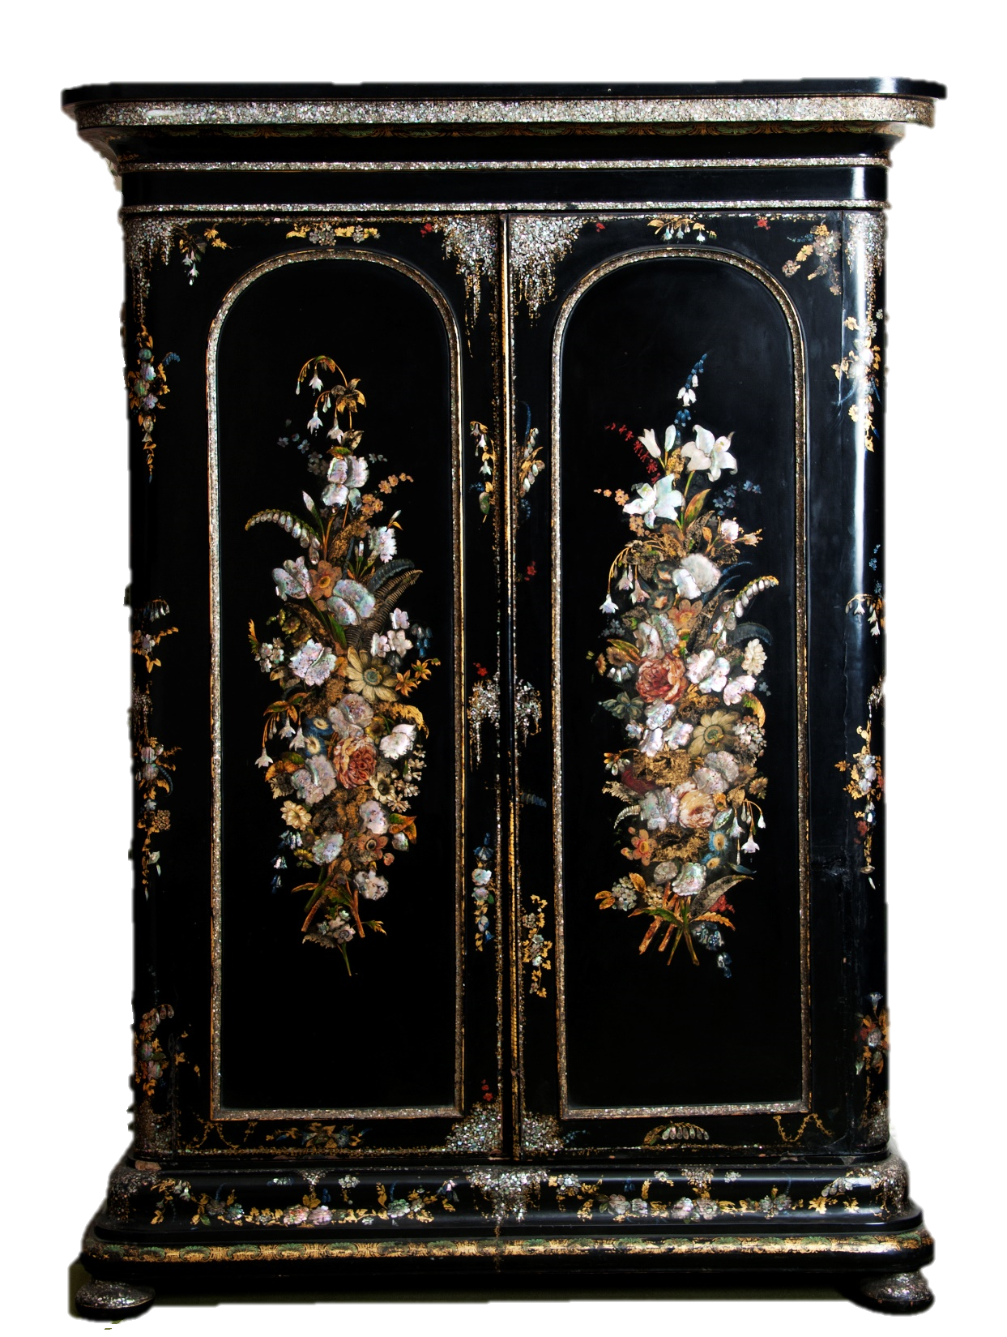
Image © Leeds Museums and Galleries

Slide 12
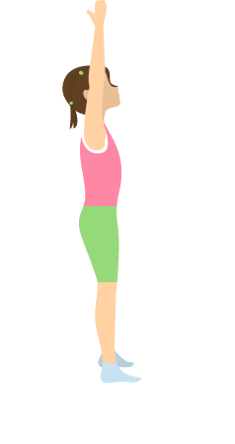
Wardrobe Stand tall like the wardrobe we’ve just looked at. Take a few minutes to plant your feet hip distance apart and breathe in and out, raising your hands up above you as you breathe in and then down by your side as you breathe out just like the wardrobe doors opening and closing. Try breathing in for four counts, holding the breath for two and then breathing out for six counts.

Slide 13
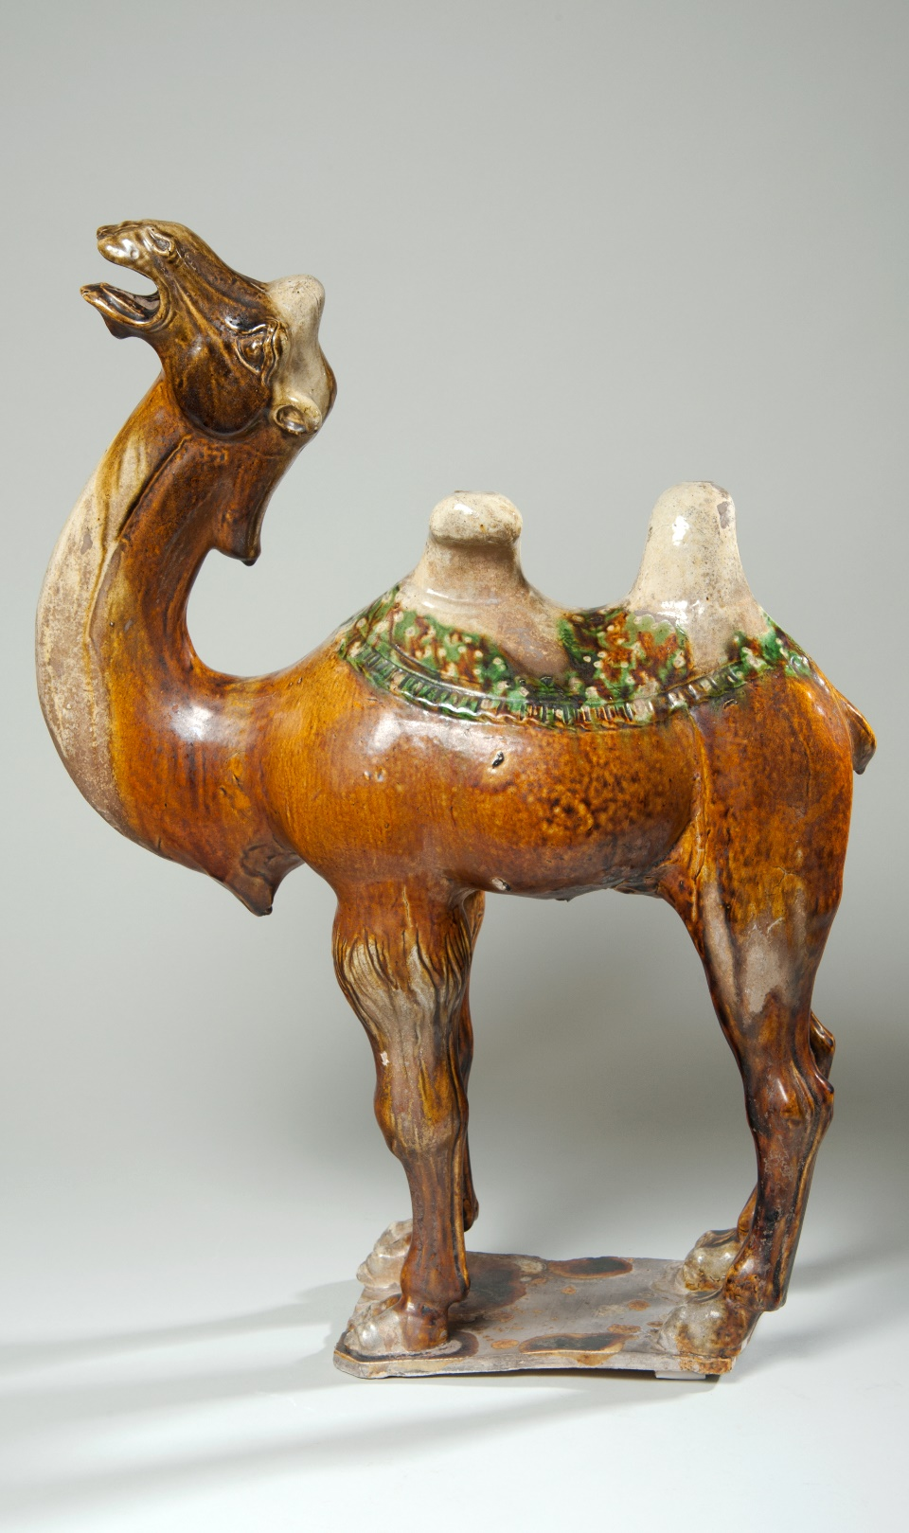
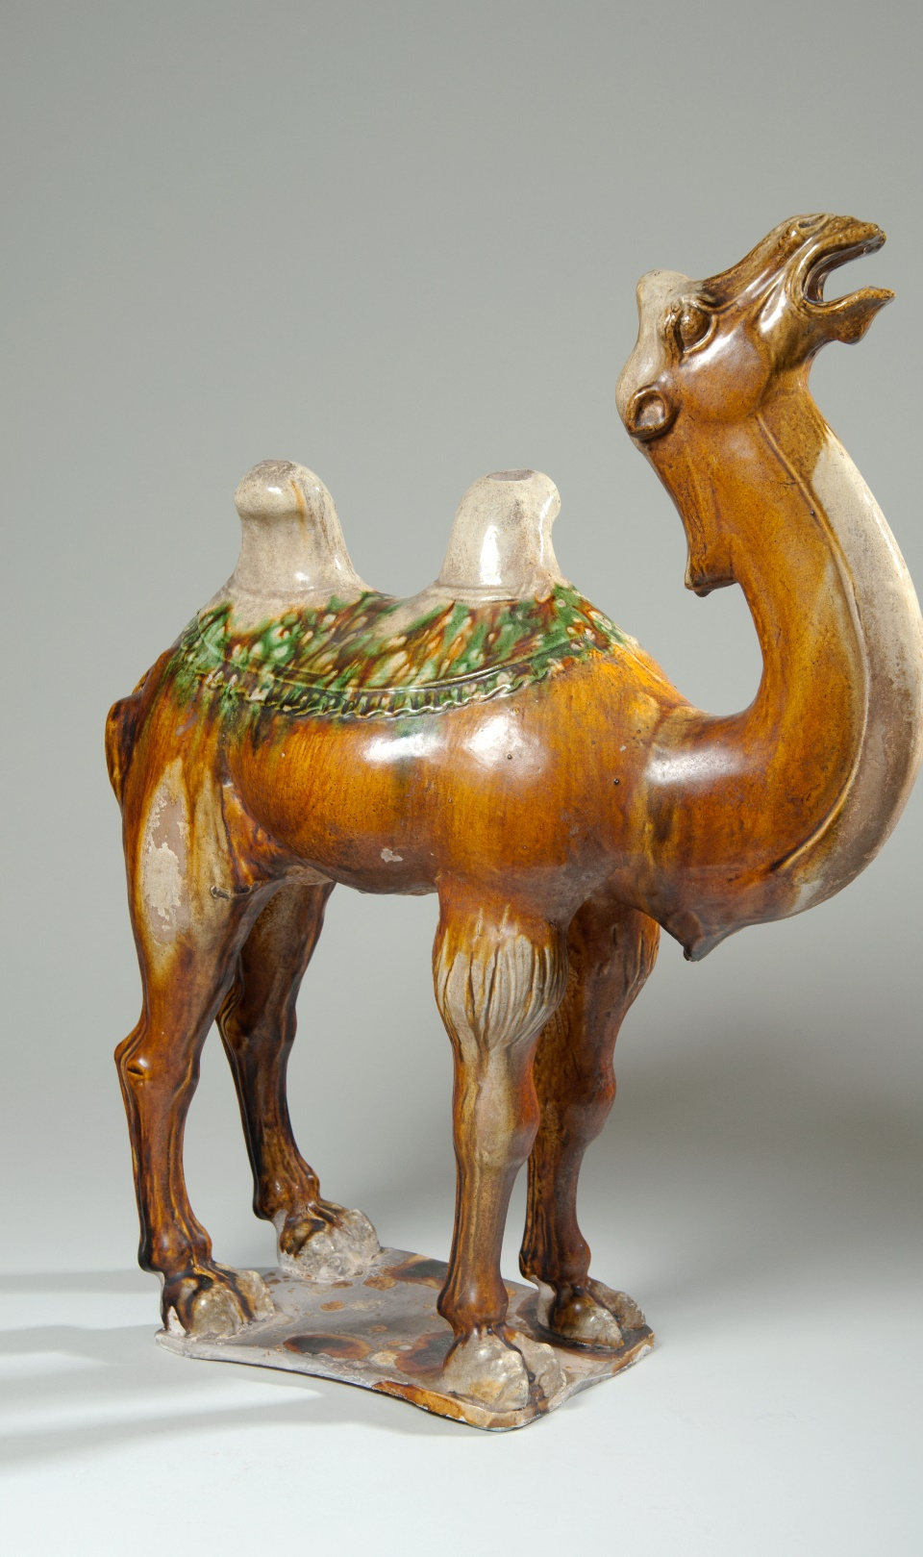
Image © Leeds Museums and Galleries

Slide 14
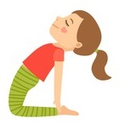
Camel Remember the humps on the back of the camel that we’ve just taken a slow look at? It’s time to channel our inner camel hump. Start sitting up on your knees with the tops of your feet resting on the floor. Then place your hands just above your bottom, almost like you’re putting them in your pockets. Then start to lean your body back stretching and stretching until you can put your hands on your feet. This is a big stretch so take it as slowly as you need to and then hold the pose for a few breaths. In and out. In and out. When you are ready, slowly make your way back up and onto your knees again.

