Slide 1
An Overview of the Holocaust
Notes:
BW

Slide 2
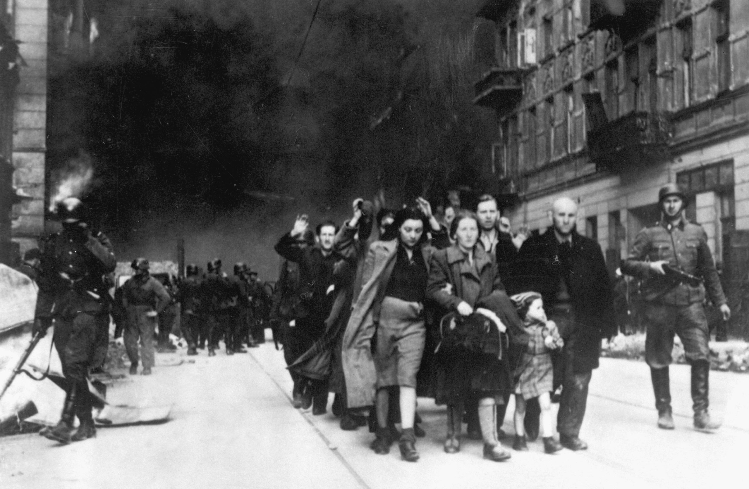
Examine this photograph. It was taken by a member of the SS, a Nazi organisation, in Warsaw during the Holocaust.
Who do you think is shown in this photograph?
What is happening here?
Notes:
BW

Slide 3
3) What do you understand the term ‘the Holocaust’ to mean?
4) The Holocaust was an example of a genocide. Do you know what the term genocide means?
Notes:
BW

Slide 4
Examine the photograph.
5) What do you think it might depict (show)?

Slide 5
6) In what year might this photograph have been taken?
7) Do you think that there is any connection between the events depicted in this photograph and the Holocaust?
8) When do you think the Holocaust occurred?

Slide 6
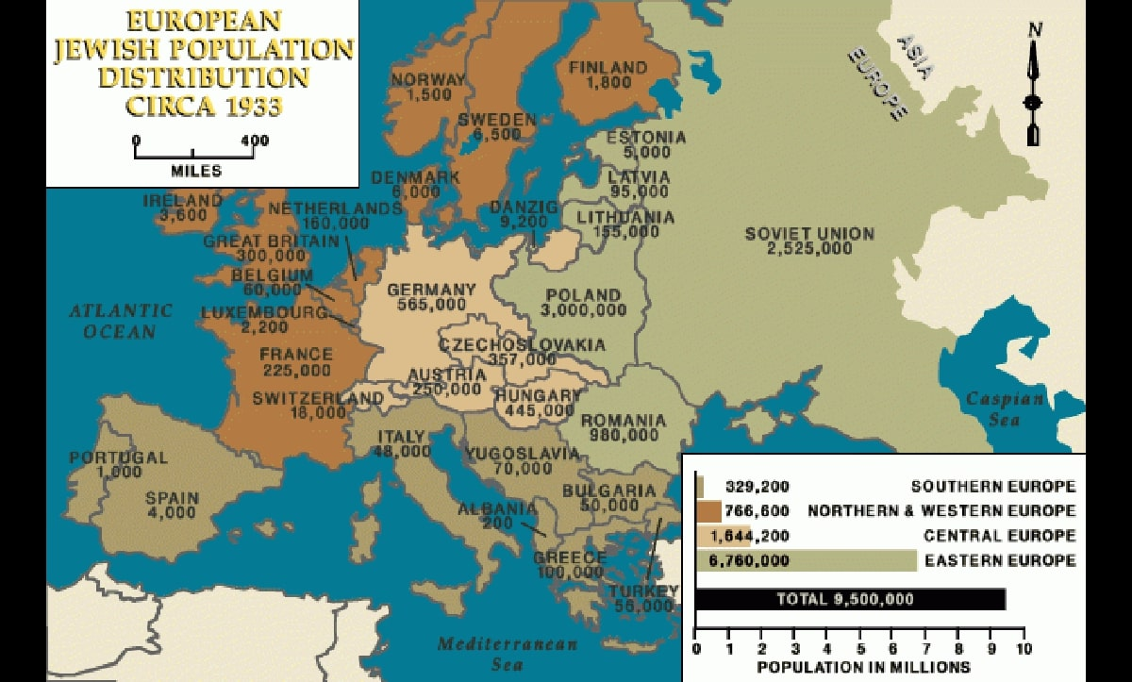
Study the map. It indicates the approximate size of Jewish populations in European countries at the time that the Nazis came to power in Germany.
9) Where do you think the Holocaust took place?
Courtesy of USHMM.

Slide 7
The ‘Holocaust by bullets’
The Holocaust started at the time of the German invasion in June 1941 of the Soviet Union during the Second World War.
As the German army advanced through the Baltic states, Belarus, Russia and Ukraine, SS killing squads, called Einsatzgruppen, and their collaborators organised mass shootings of Jews and others.
Around half the victims of the Holocaust were murdered in these areas.

Slide 8
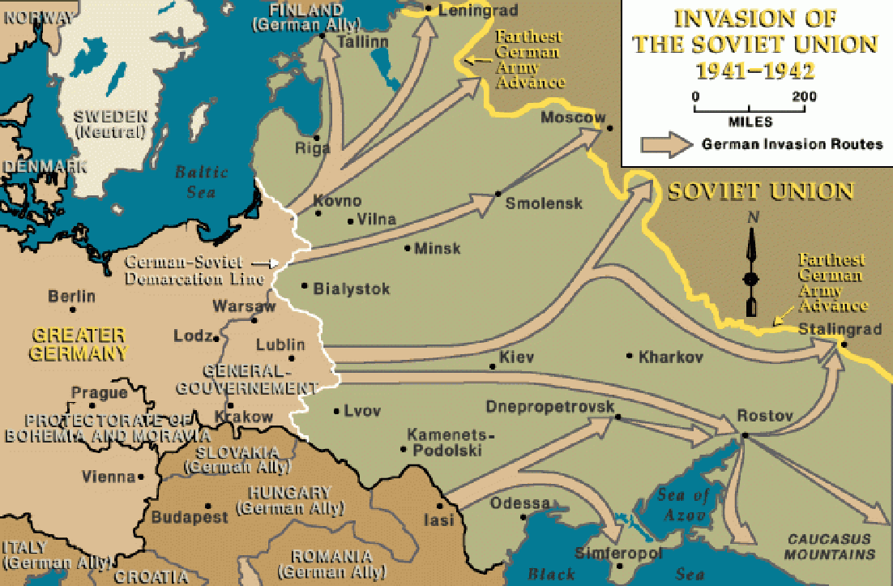
The ‘Holocaust by bullets’
Courtesy of USHMM.

Slide 9
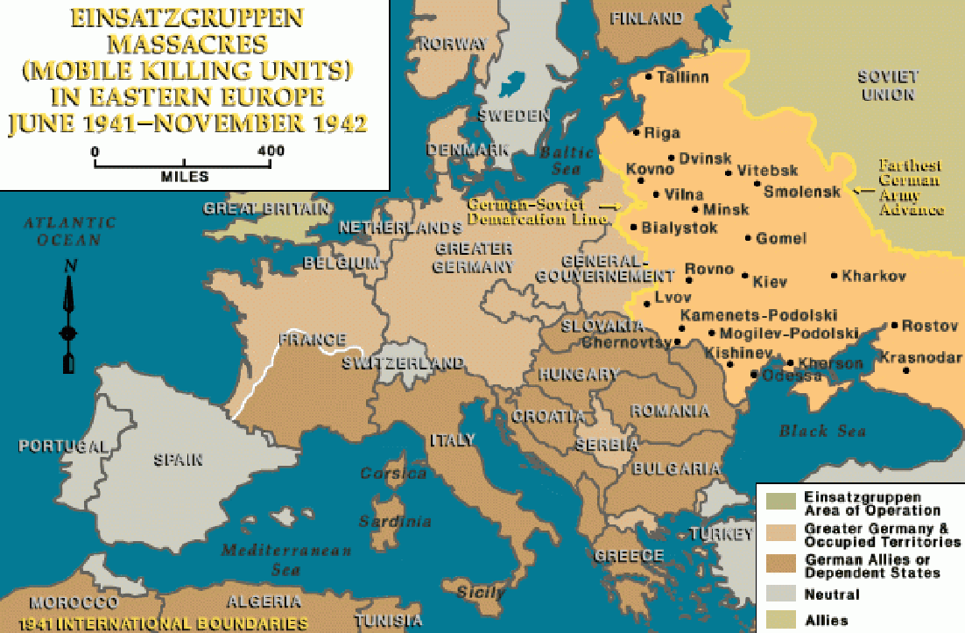
Courtesy of USHMM.

Slide 10
10) This map is from a SS report. What part of the world / countries does it depict?
11) What do you think that the map shows ?
12) What the Nazis’ ultimate aim for the Jewish population of these areas?

Slide 11
The Holocaust in camps
The Nazis had an extensive network of camps across Europe. In August 1942, experiments started at Auschwitz with the use of gas to murder people. By 1942, mass murder of Jews by gas was being carried out at Auschwitz and other extermination camps, such as Sobibór, Chełmno and Treblinka.
In camps which were also labour camps, such as Auschwitz, some Jews were selected to work as enslaved labourers.

Slide 12
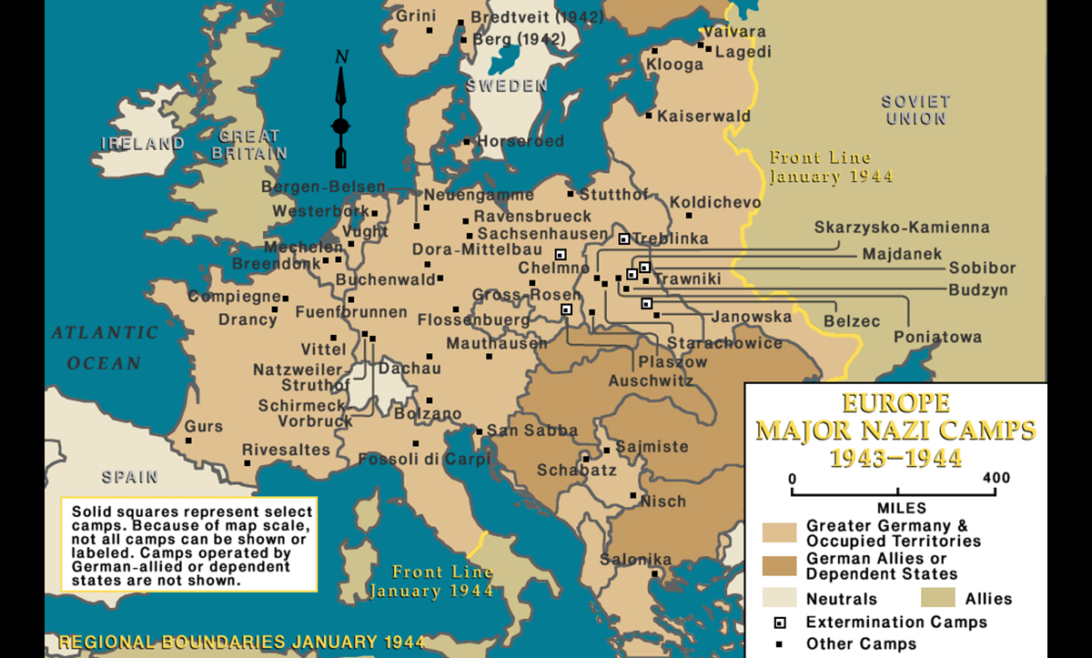
Look at the map.
13) Where were the extermination camps situated?
14) Were they in the main part of Germany?
Courtesy of USHMM.

Slide 13
Transports
Augusta Spitz and Therese Steiner were two Austrian Jewish women who lived in Guernsey in the Channel Islands.
The Channel Islands were occupied by Germany during the Second World War. Spitz and Steinerwere arrested in Guernsey and deported to France, and then to Auschwitz.

Slide 14
Jews from across Europe were transported by train to the extermination camps.
This document is a list of those deported to Auschwitz from a camp, Drancy in France, who arrived in Auschwitz on 23 July 1942. Spitz and Steiner were murdered in Auschwitz.
13) Find the names Augusta Spitz and Therese Steiner on the list.

Slide 15
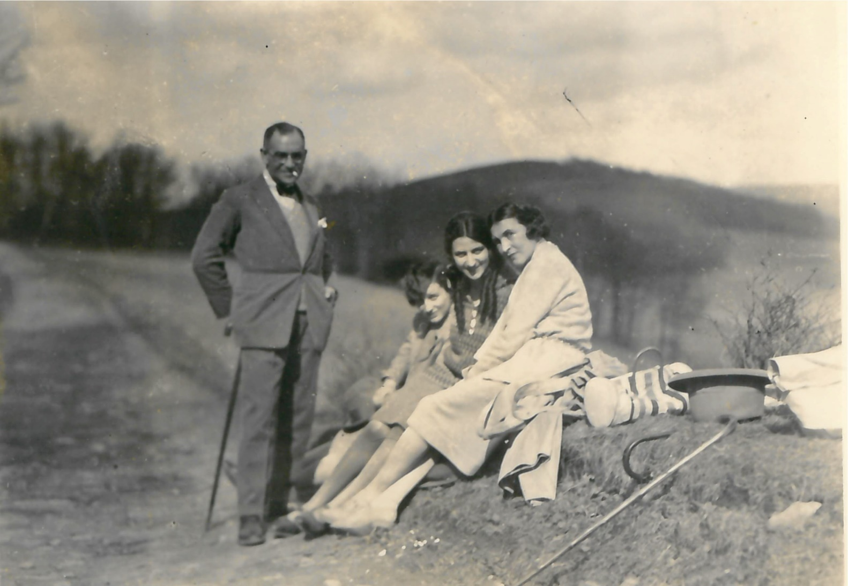
Who were the victims of the Holocaust?: German Jews
Members of the Robinsohn family on a walk in Germany, 1928.
In the late 1930s, the Robinsohn family left Hamburg and emigrated to Britain.

Slide 16
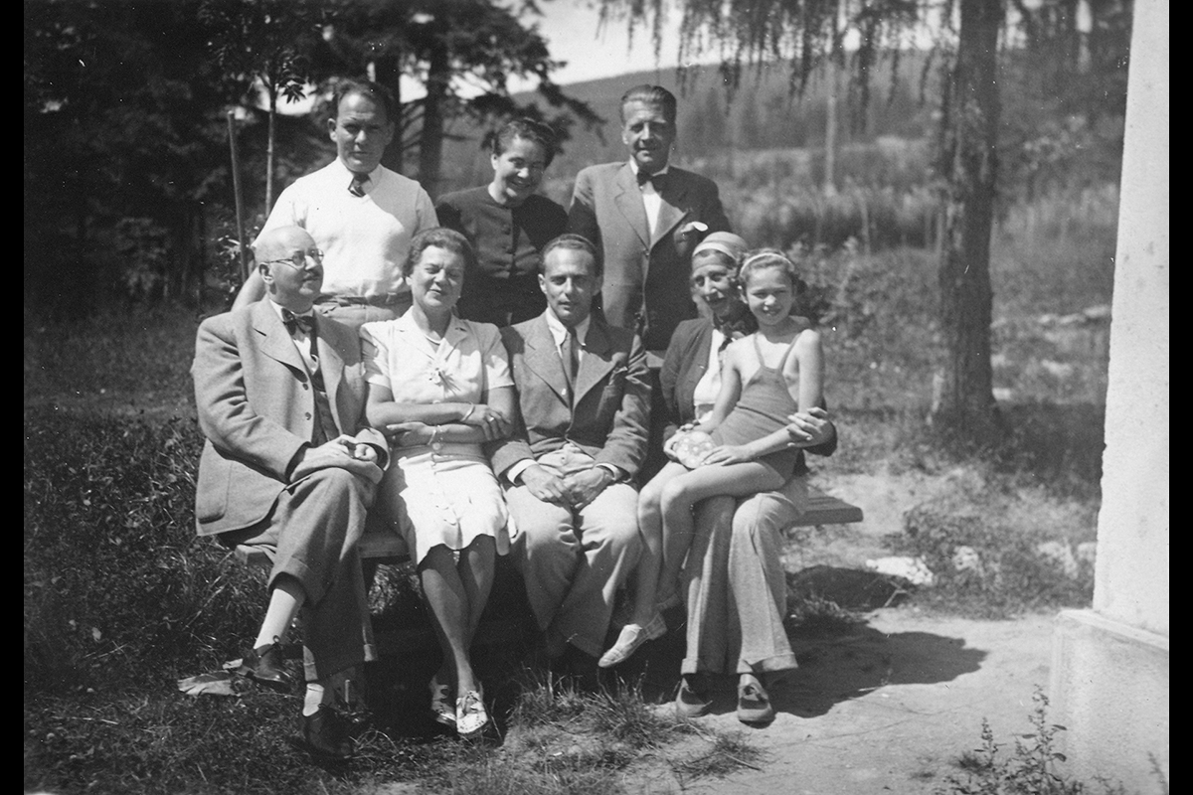
Who were the victims of the Holocaust?: Jews from across Europe
Eugen and Helen Fürze, a family with Jewish roots, relax with their family and friends. This photo was taken in the 1930s in Susice, Czech Republic.
Eugen emigrated to Britain with his father and son in 1938. His wife Helene stayed with her mother in Prague. In 1942 she was murdered by the Nazis, likely in Majdanek (a concentration and extermination camp in Poland).

Slide 17
Victims of the Holocaust: Roma
Up to about 500,000 Roma were murdered by the Nazis and their collaborators in extermination camps and in mass shooting in Soviet Territories.
Roma were considered racially inferior by the Nazis and targeted for murder.

Slide 18
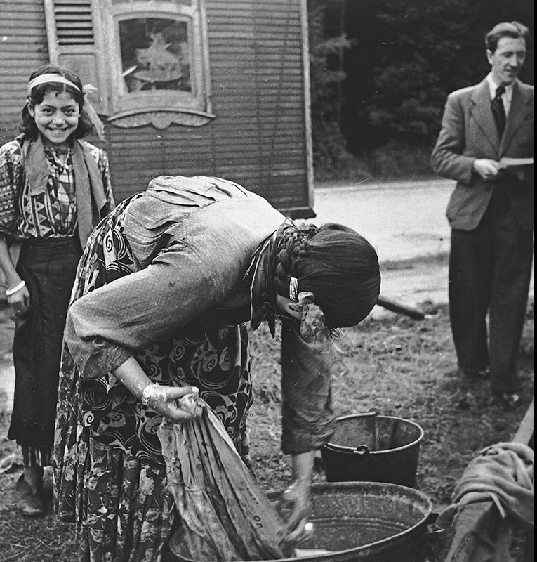
Victims of the Holocaust: Roma
A Roma family in Europe, 1930s.
Image Courtesy of USHMM – do not reproduce without permission of USHMM.

Slide 19
Who were the perpetrators of the Holocaust?
Read the document on the following two slides by Oswald Pohl, a senior SS administrator of concentration and extermination camps, and then answer these questions. His statement was given as part of the Nuremburg War Crimes tribunal.
15) Who does Pohl blame for the programme to exterminate the Jews at Auschwitz?
16) Do you entirely trust his account?

Slide 22
Collaboration
The Nazis were assisted in their campaign of genocide by collaborators from countries other than Germany. This photograph shows German soldiers photographing an attack on Jews in Lvov, in the Ukraine in 1942. The local population, and not Germans, were carrying out the attack.
Sometimes collaborators carried out their own attacks, sometimes they joined the Nazis, for example in the SS. In some countries, for example Croatia, pro-Nazi regimes committed genocide.

Slide 23
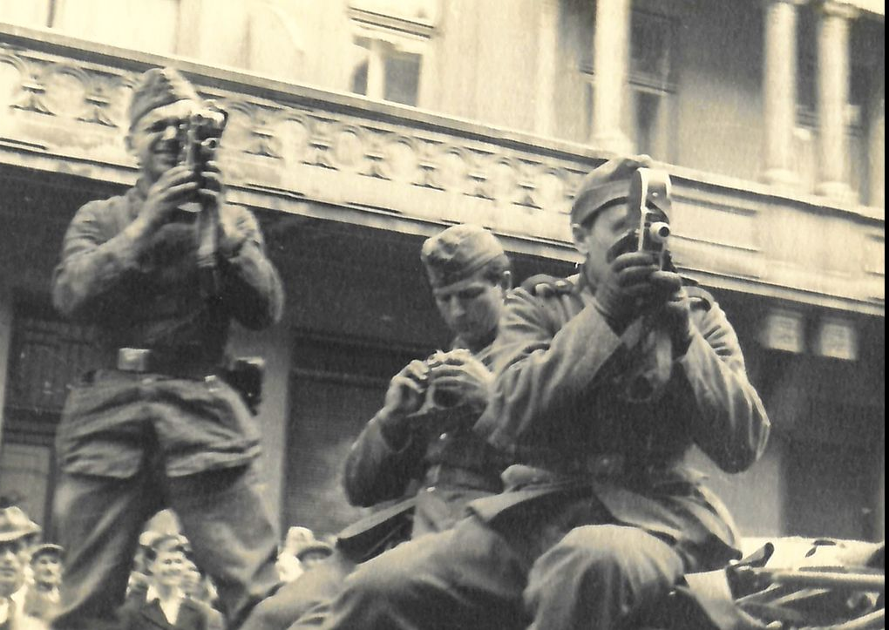
Collaboration
German Army soldiers film the massacre of Jews in the Lvov Pogroms of July 1941, carried out by the Einzatzgruppe C and the Ukrainian National Militia.

