Slide 2
The Royalists
The Royalists believed in the ‘Divine Right of Kings’ – that the king was appointed by God and could rule without Parliament.
They accepted that the king was the commander of the armed forces and head of the Church of England.
It was the king’s right to appoint ministers and to wage wars.

Slide 3
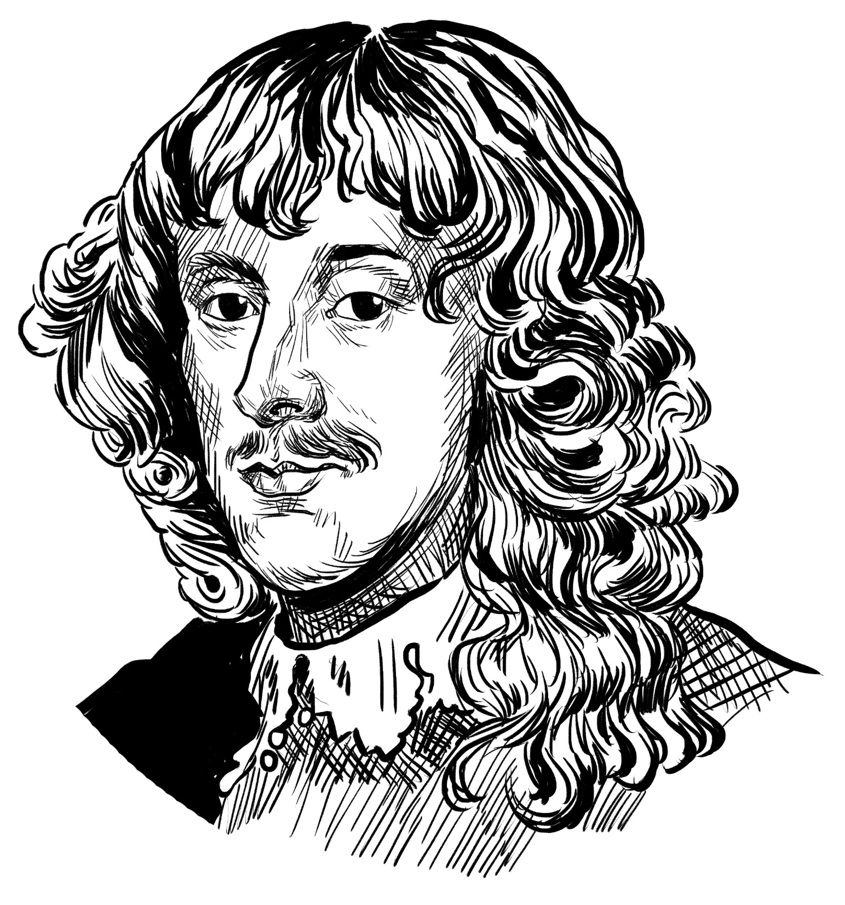
James Stewart
1st Duke of Richmond
1612-1655
Leader of the Royalist team. A relative of the King, and very wealthy.
Skilled at bargaining and fighting. Defended Oxford for the King and led the Royalist negotiators at Uxbridge.

Slide 4
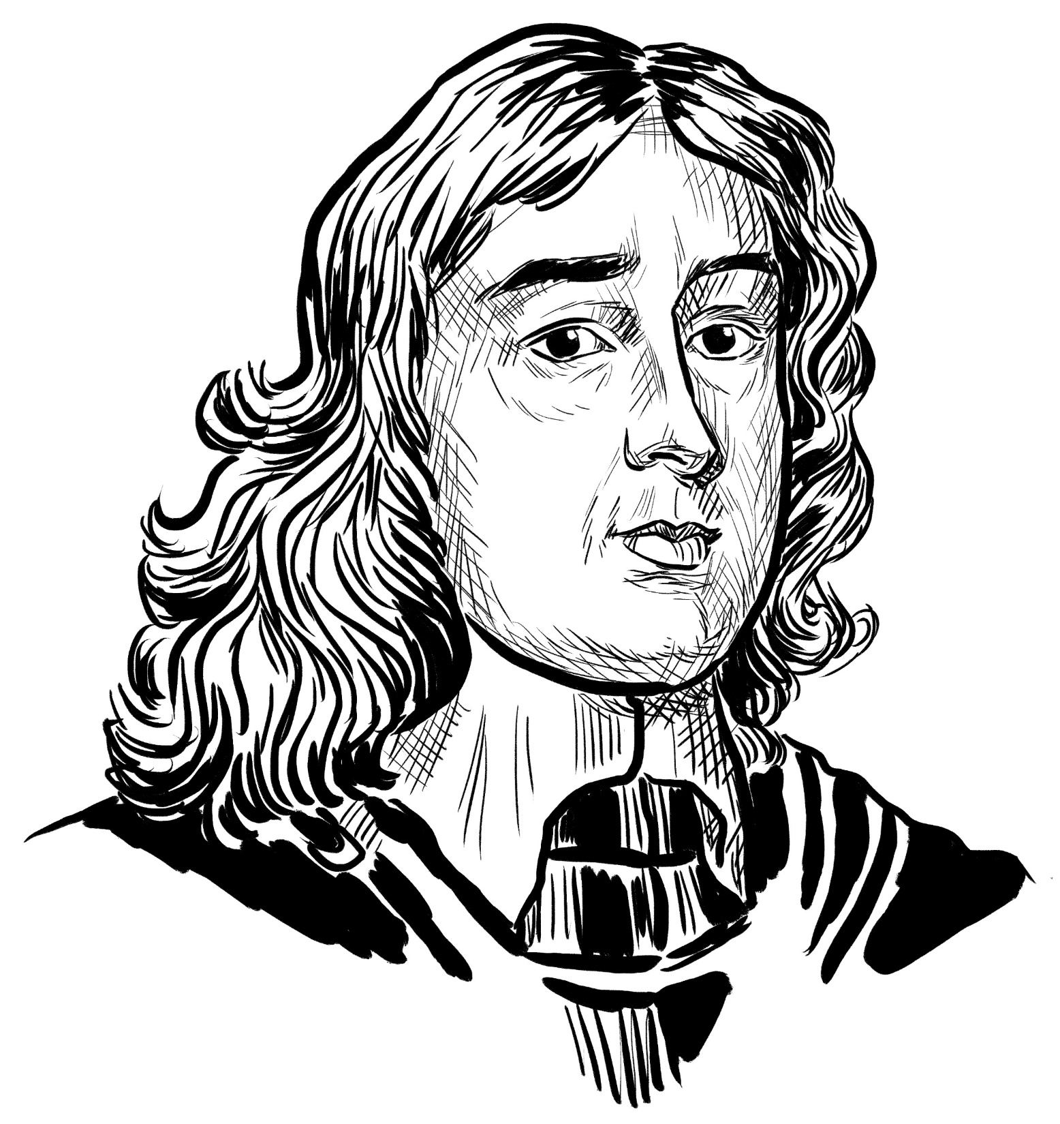
William Seymour
1st Marquis of Hertford 1588-1660
A loyal companion to the King during his trial and imprisonment.
Helped arrange the King’s funeral, but quarrelled with his nephews.

Slide 5
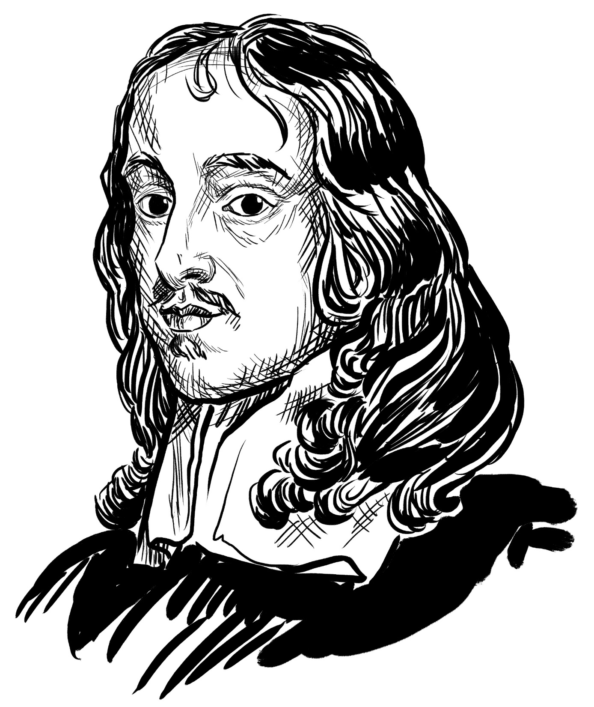
Thomas Wriothesley
4th Earl of Southampton
1607-1667
Known for his honesty and lack of corruption.
Originally a supporter of Parliament, but changed sides due to the violence of some of the Parliamentary supporters.

Slide 6
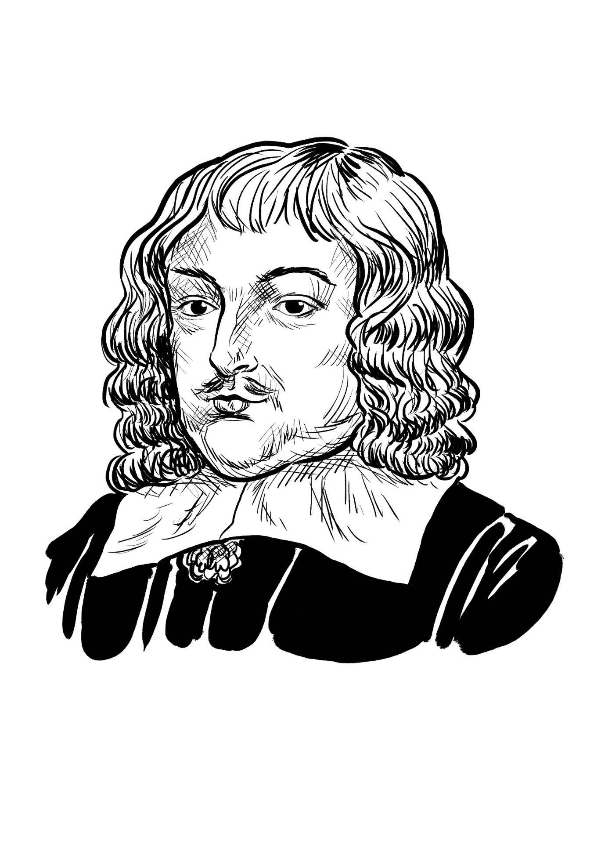
Henry Pierrepoint
2nd Earl of Kingston-upon-Hill
1606-1680
Loyal but temperamental.
Challenged his son-in-law to a duel. Fought a fellow MP in Parliament.

Slide 7
Francis Leigh
1st Earl of Chichester
1598-1653
Captain of the King’s bodyguard
Changed sides after some gentle encouragement from the King.

Slide 8
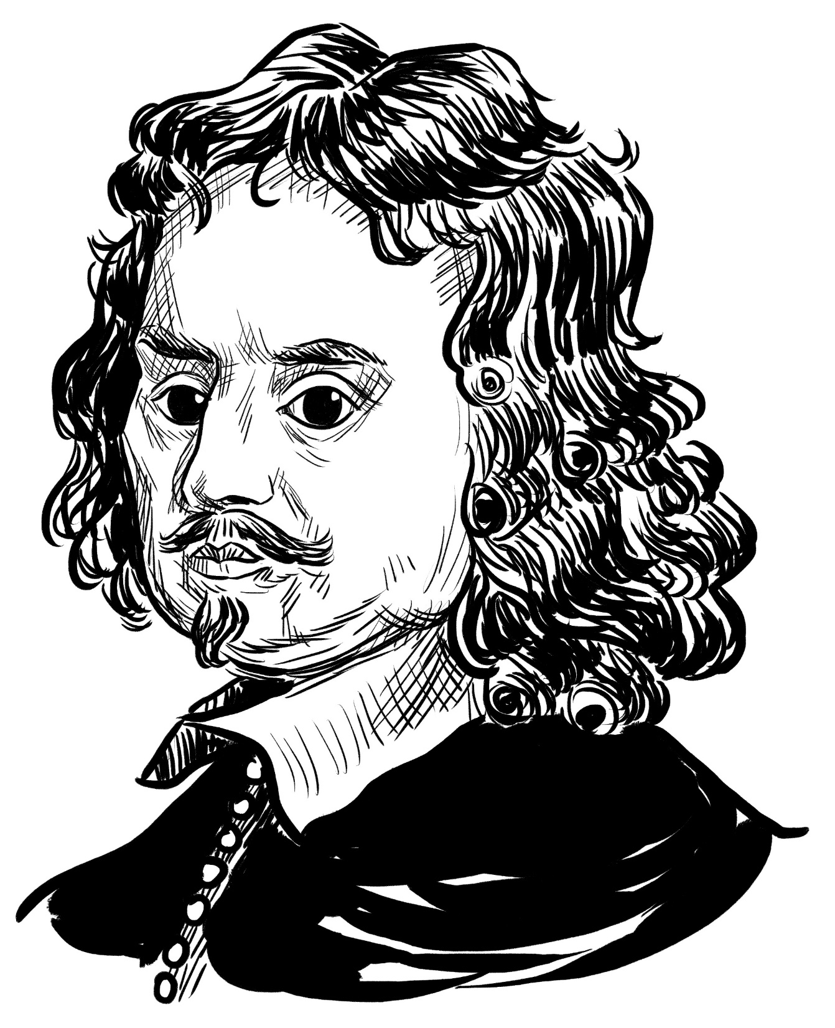
Edward Hyde
1st Earl of Clarendon
1609-1674
A lawyer, interested in reading and philosophy.
Valued friendship above anything.
Described Cromwell as a ‘brave bad man’.

Slide 9
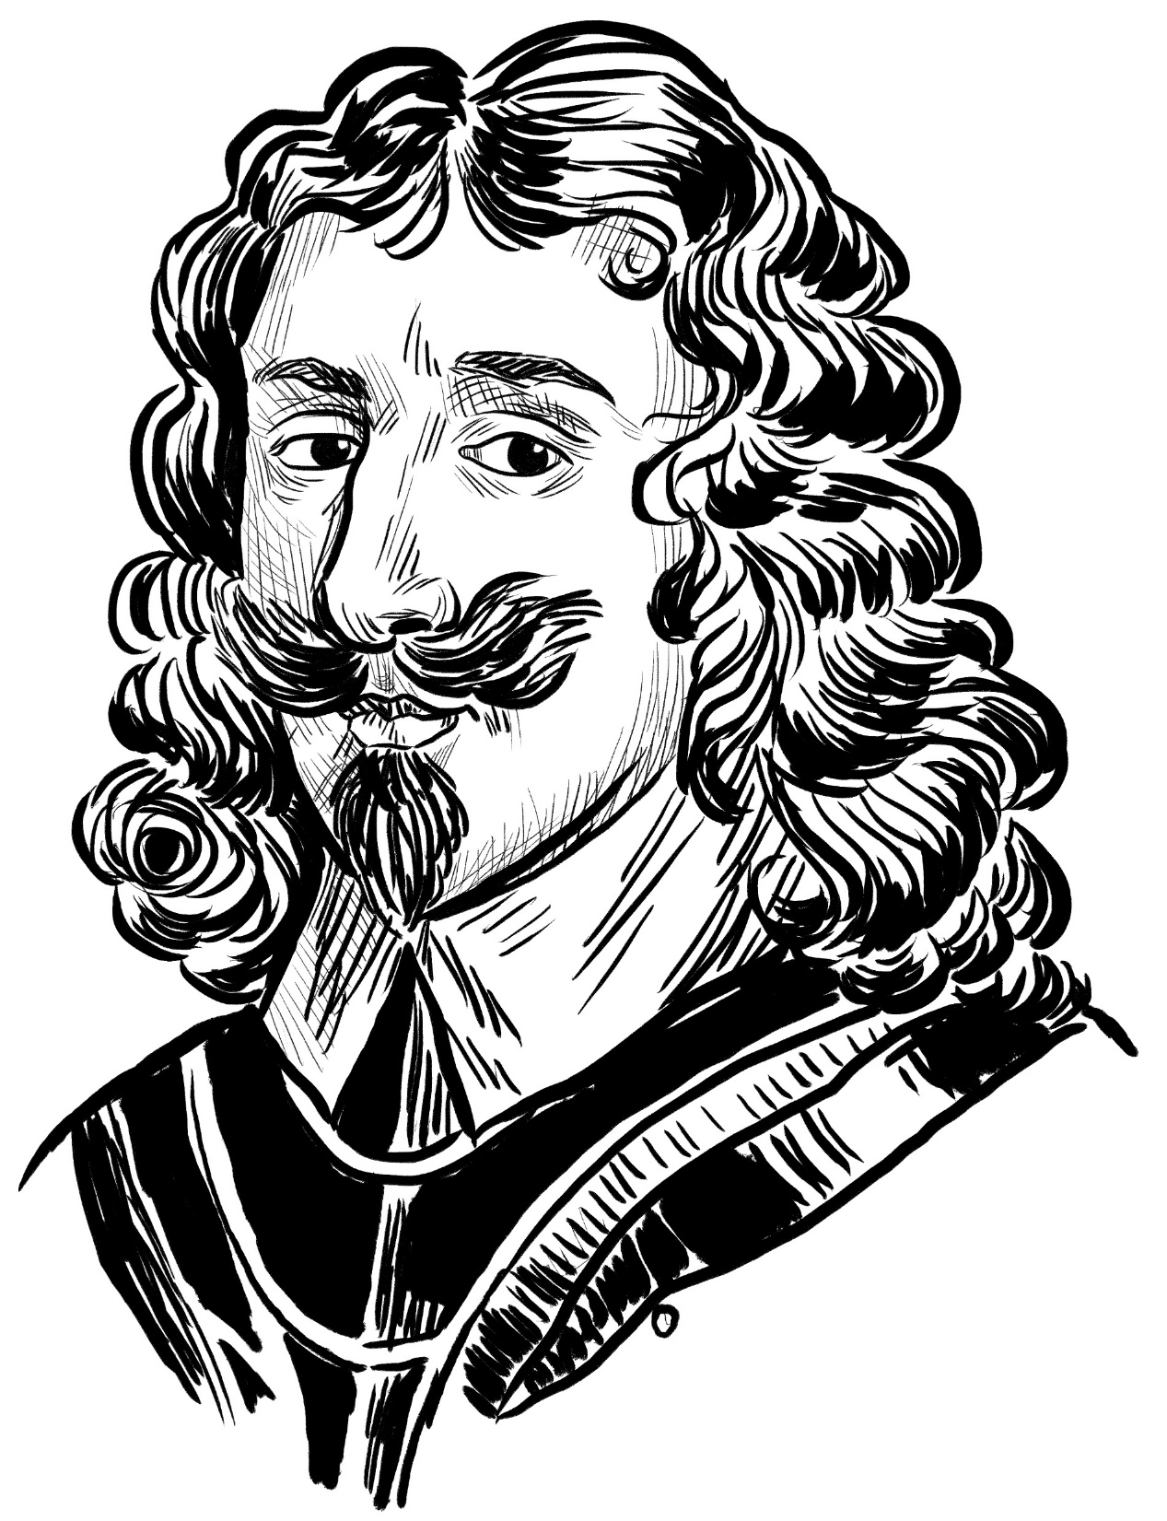
Arthur Capel
1st Baron Capel of Hadham 1604-1649
One of England’s richest men.
Fought in the cavalry early in the Battle of Edgehill in 1642.
Surrendered to Parliament in return for his life, but was later executed anyway.

Slide 10
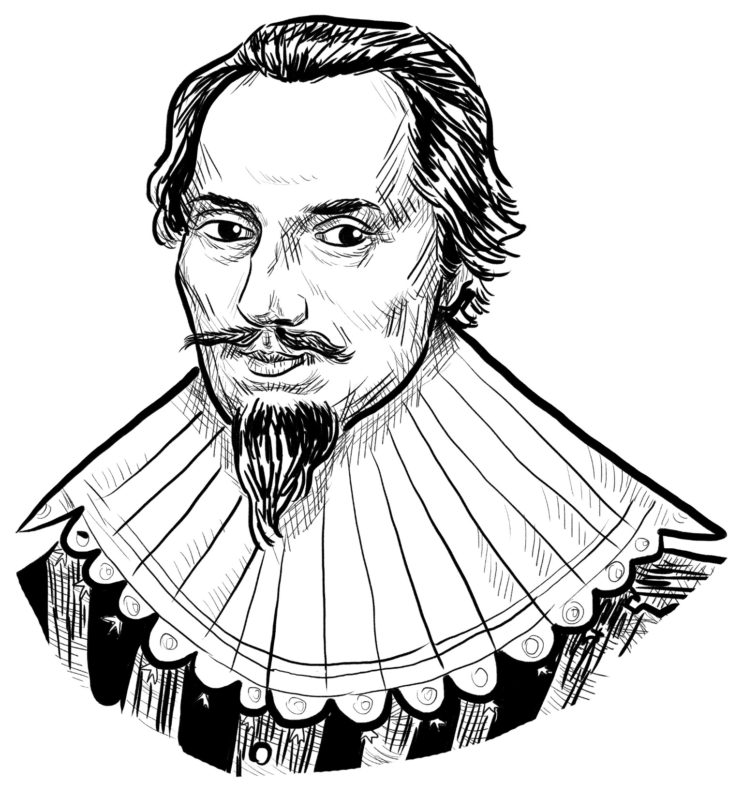
Francis Seymour
1st Baron Seymour of Trowbridge
1590-1664
An early Parliamentary supporter, but later changed sides.
A well-informed MP with strong views about liberty.

Slide 11
Robert Hatton
1582-1653
A loyal supporter of the King, but very bad with money.
Had to flee the country because of his debts.

Slide 12
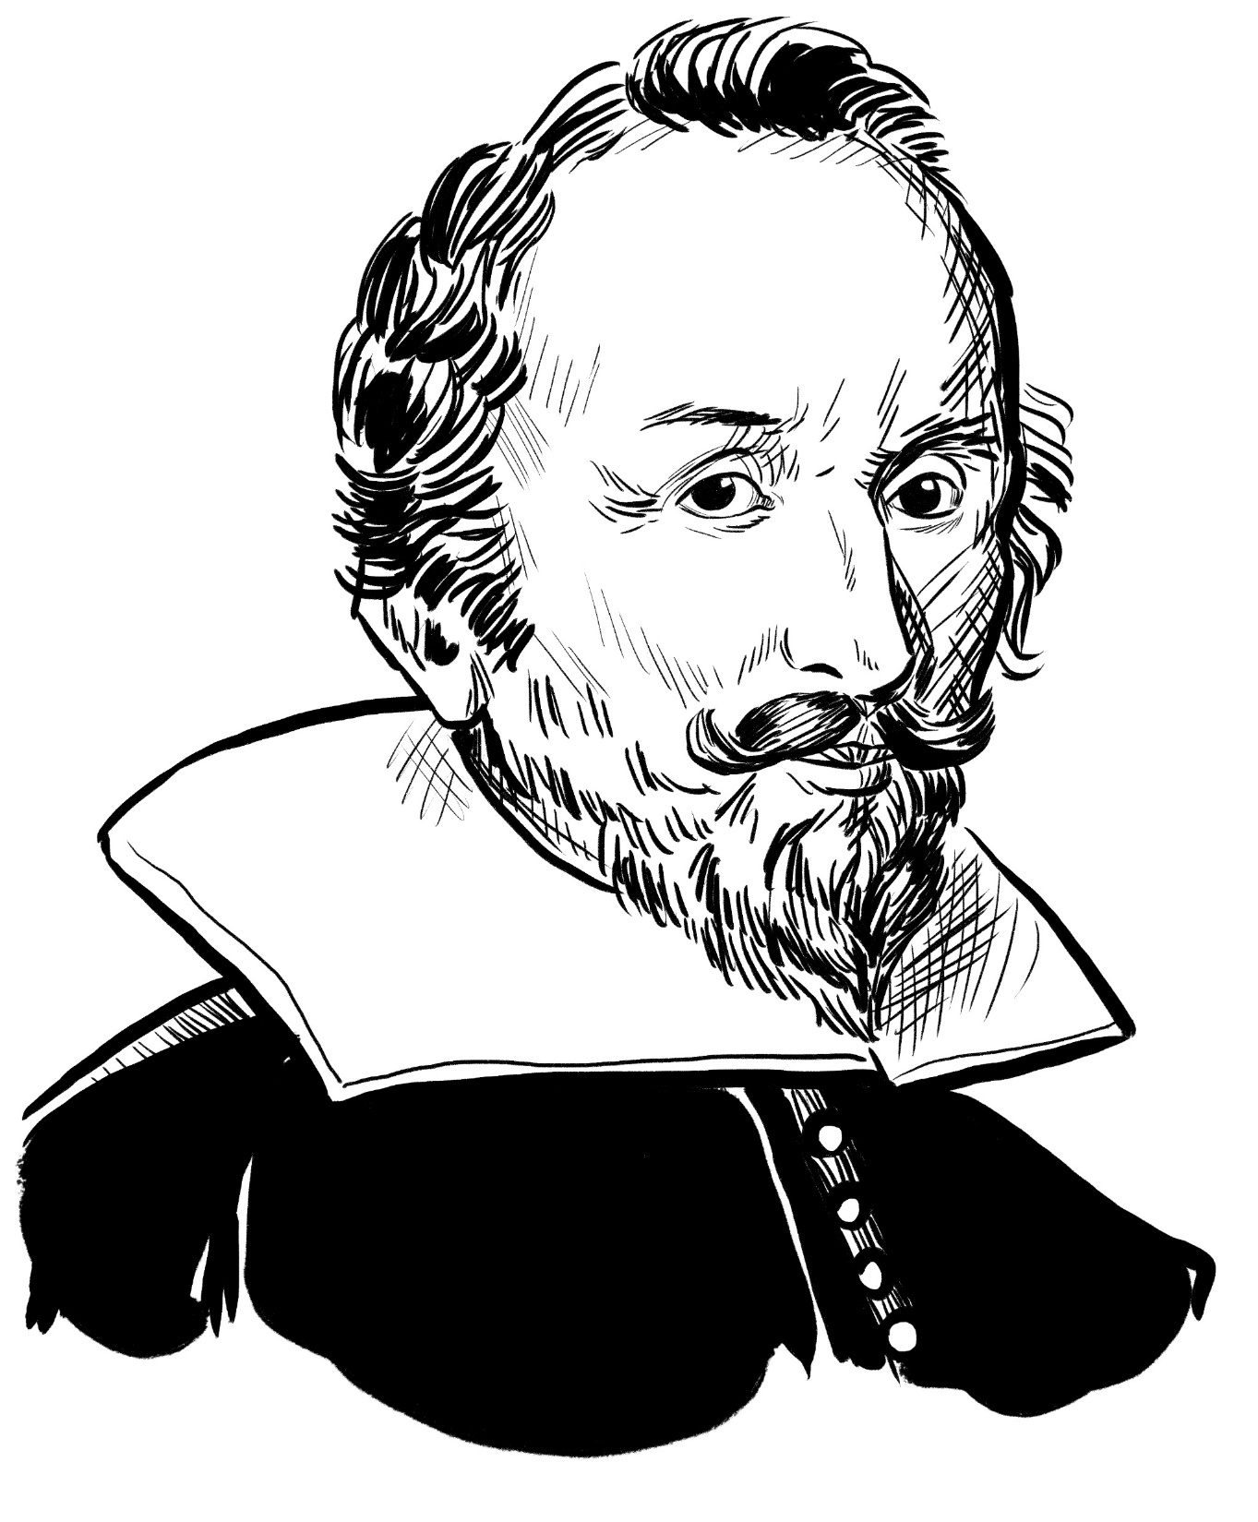
John Colepeper
1st Baron Colepeper
c1600-1660
Had a long military record at home and overseas.
Advised Parliament on foreign affairs. Liked to compromise in discussions.

Slide 13
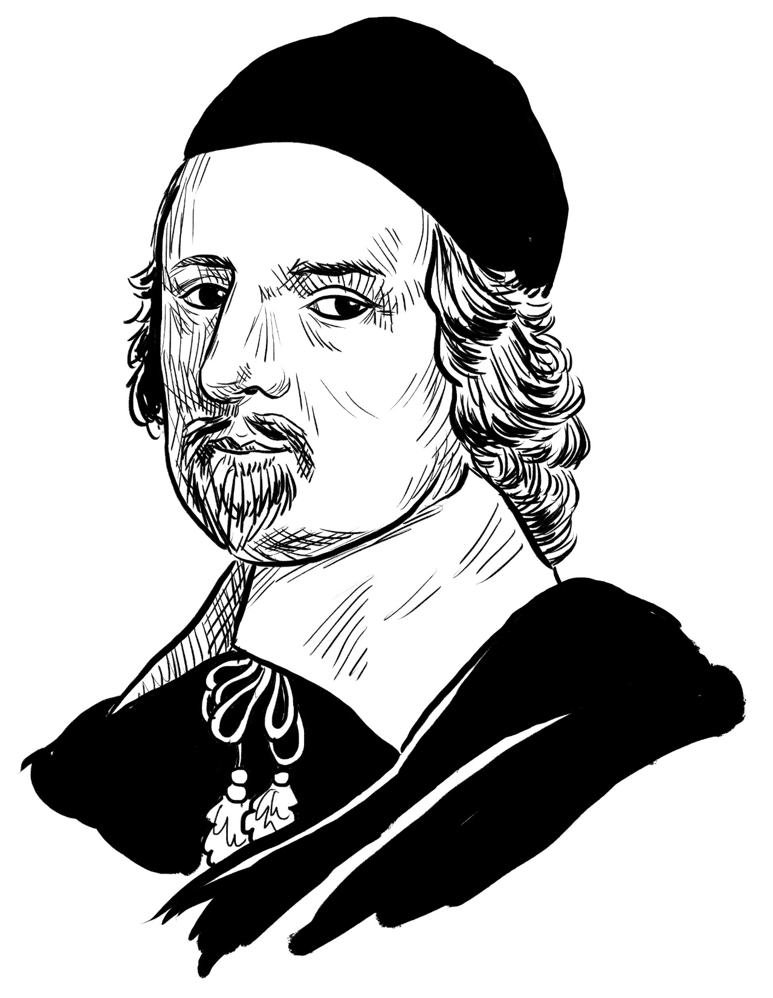
Sir Edward Nicholas
1593-1669
More of an adviser than a soldier.
Helped arrange the King’s surrender in 1646.

Slide 14
Sir Richard Lane
1584-1650
A lawyer, representing lords, bishops and other important people in court.

Slide 15
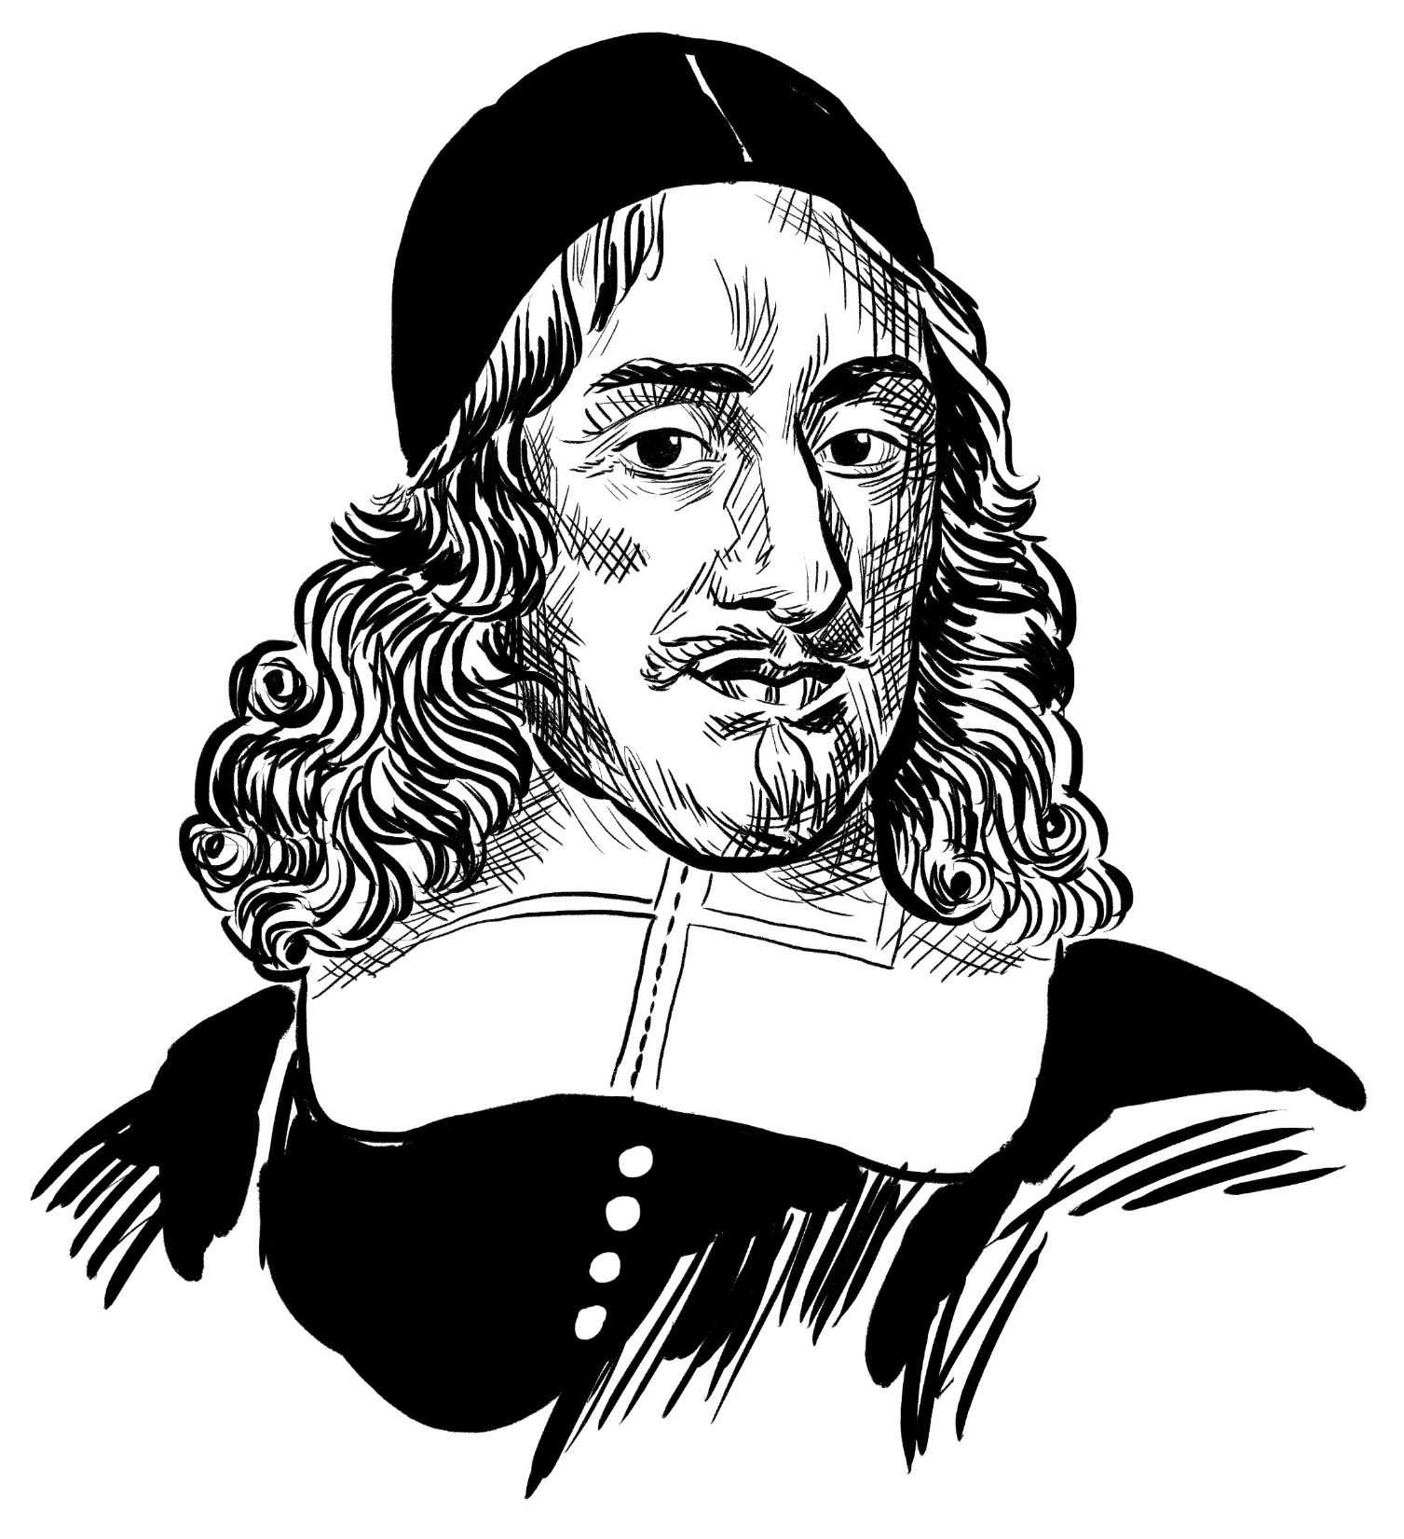
Orlando Bridgeman
1st Baronet of Great Lever 1606-1674
A wealthy lawyer and clever negotiator.
Was an unsuccessful commander in the Civil Wars.

Slide 16
Sir Thomas Gardiner
1591-1652
Trained as a lawyer.
His daughter was a maid to the wives of King Charles I and Charles II.

Slide 17
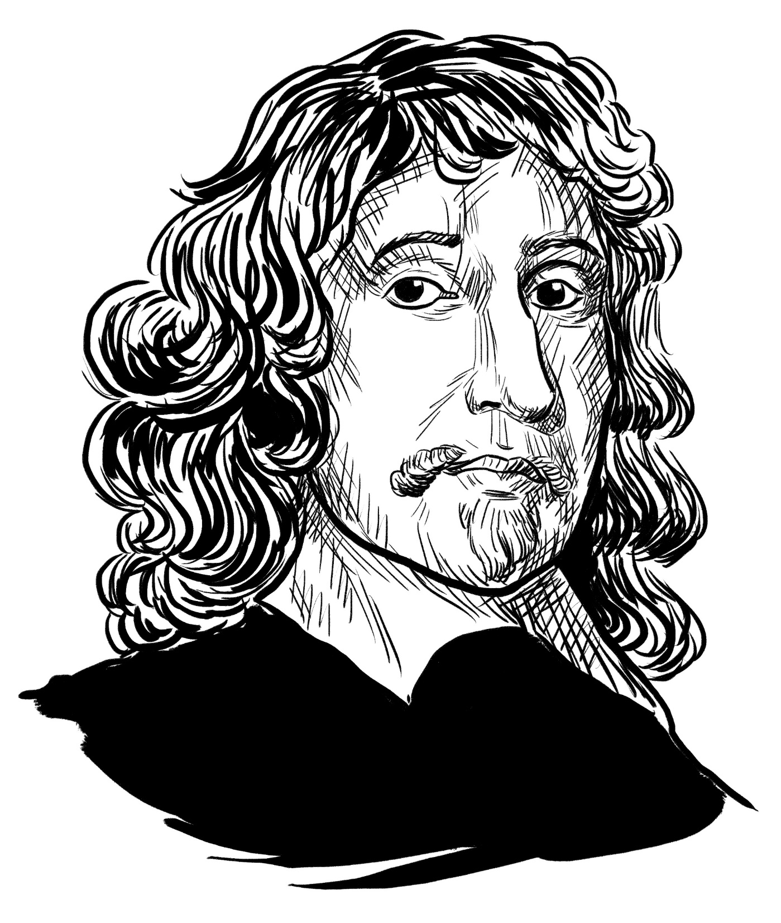
John Ashburnam
1603-1671
A foreign diplomat in his twenties.
Clever but self-serving.
Nick-named ‘Jack’ by the King.

Slide 18
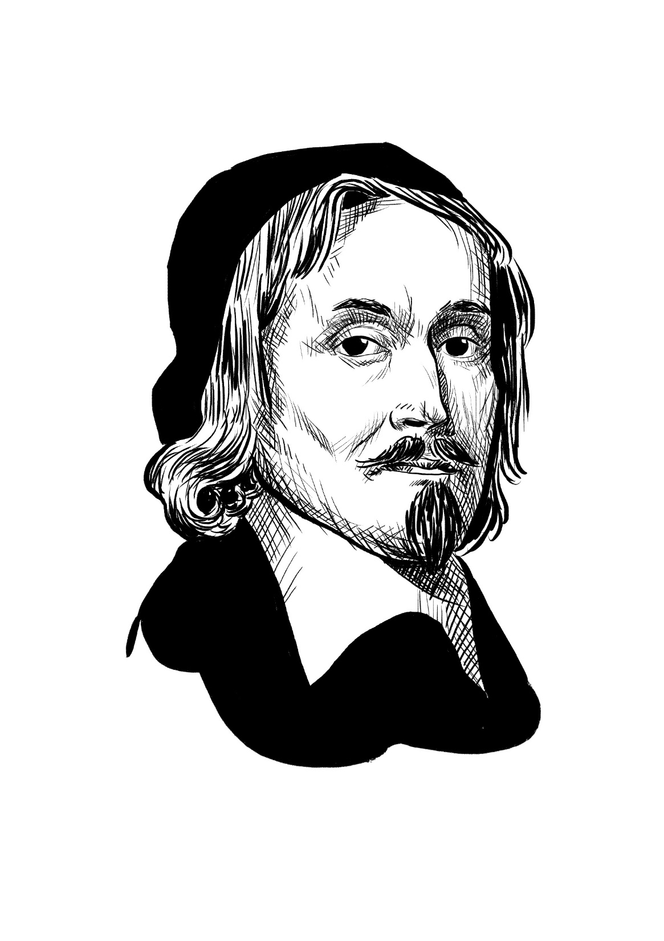
Dr Richard Steward
[1593]-1651
One of England’s leading churchmen.
Very knowledgeable about religion and the law.

Slide 19
The Parliamentarians
Most Parliamentarians wanted a constitutional monarchy. Only some wanted to abolish the monarchy entirely.
They were determined to preserve the ‘liberties’ of the people.
They disliked the king’s costly and unsuccessful wars, and believed Parliament should play a greater role in governing the country.

Slide 20
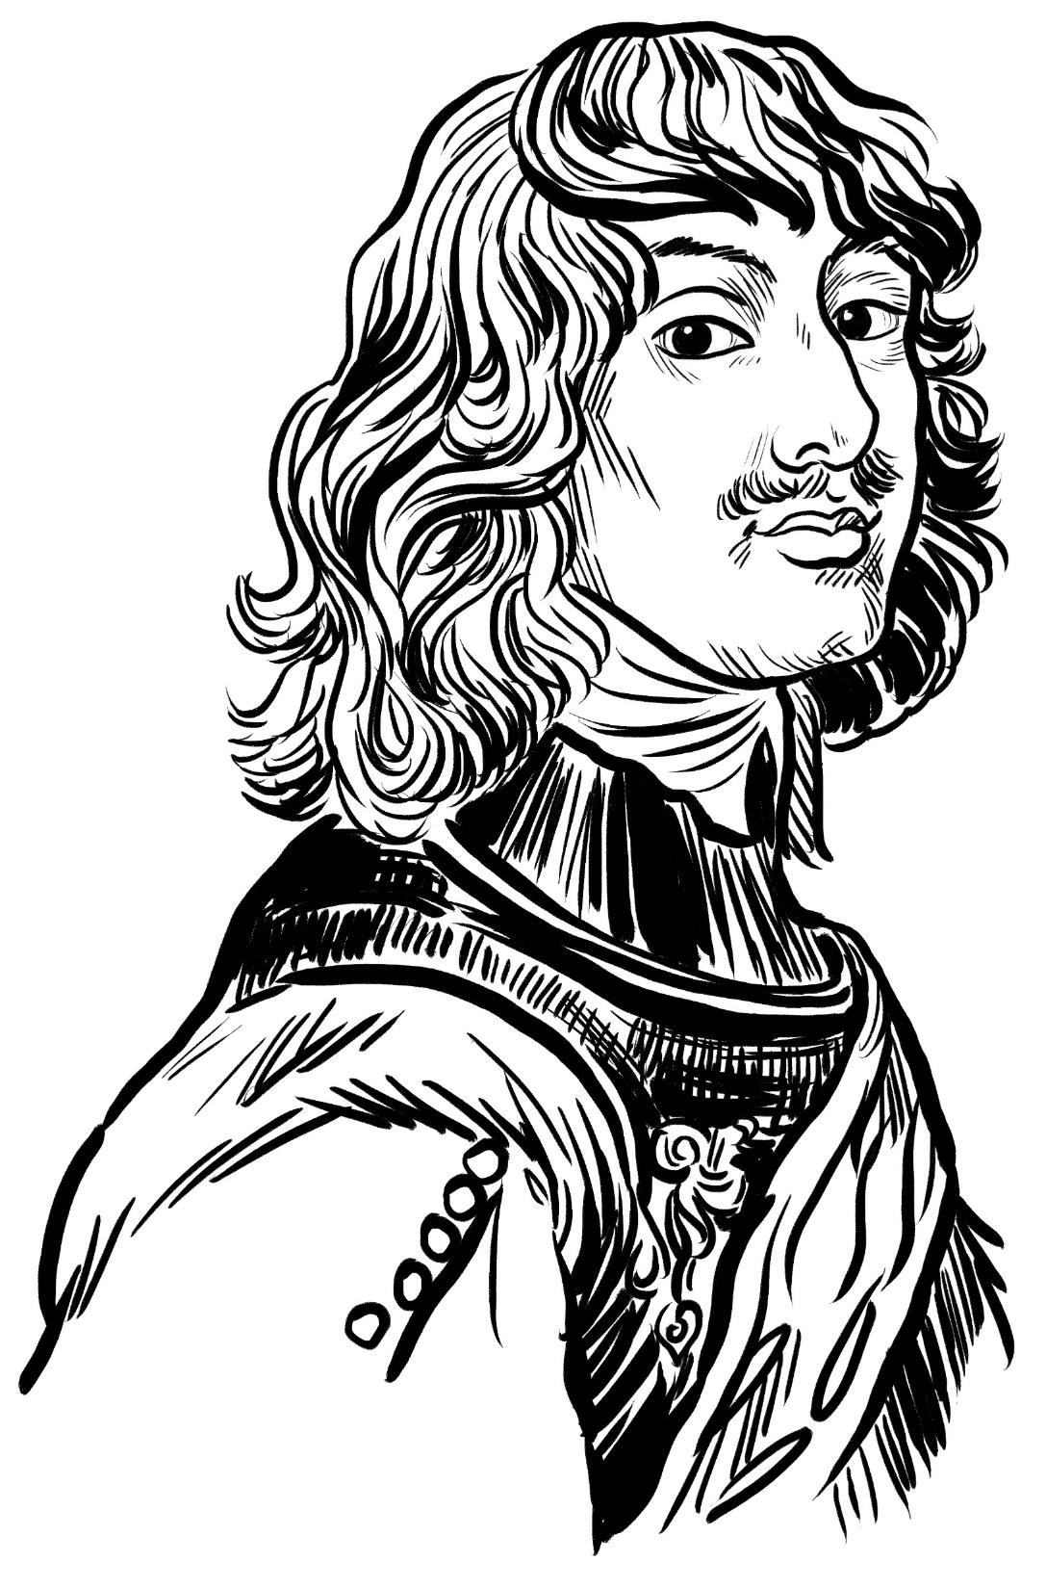
Algernon Percy
10th Earl of Northumberland
602-1668
Leader of the Parliamentary team.
From one of England’s oldest noble families.
Held moderate views and opposed the King’s execution.

Slide 21
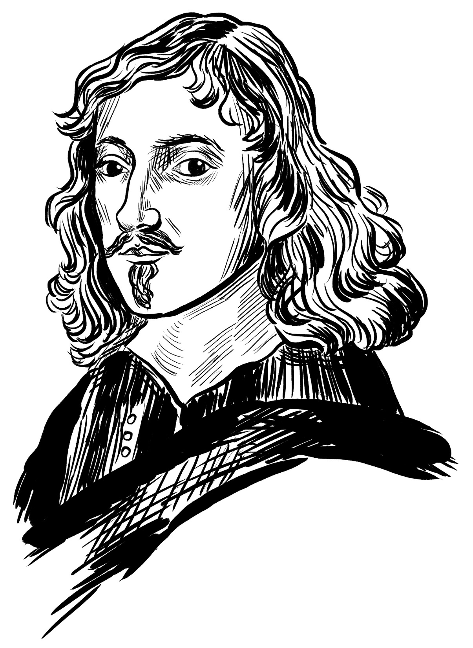
Sir Bulstrode Whitlocke
1605-1675
An influential man with a legal background and a love of music.
Advised Cromwell to take the title of King.

Slide 22
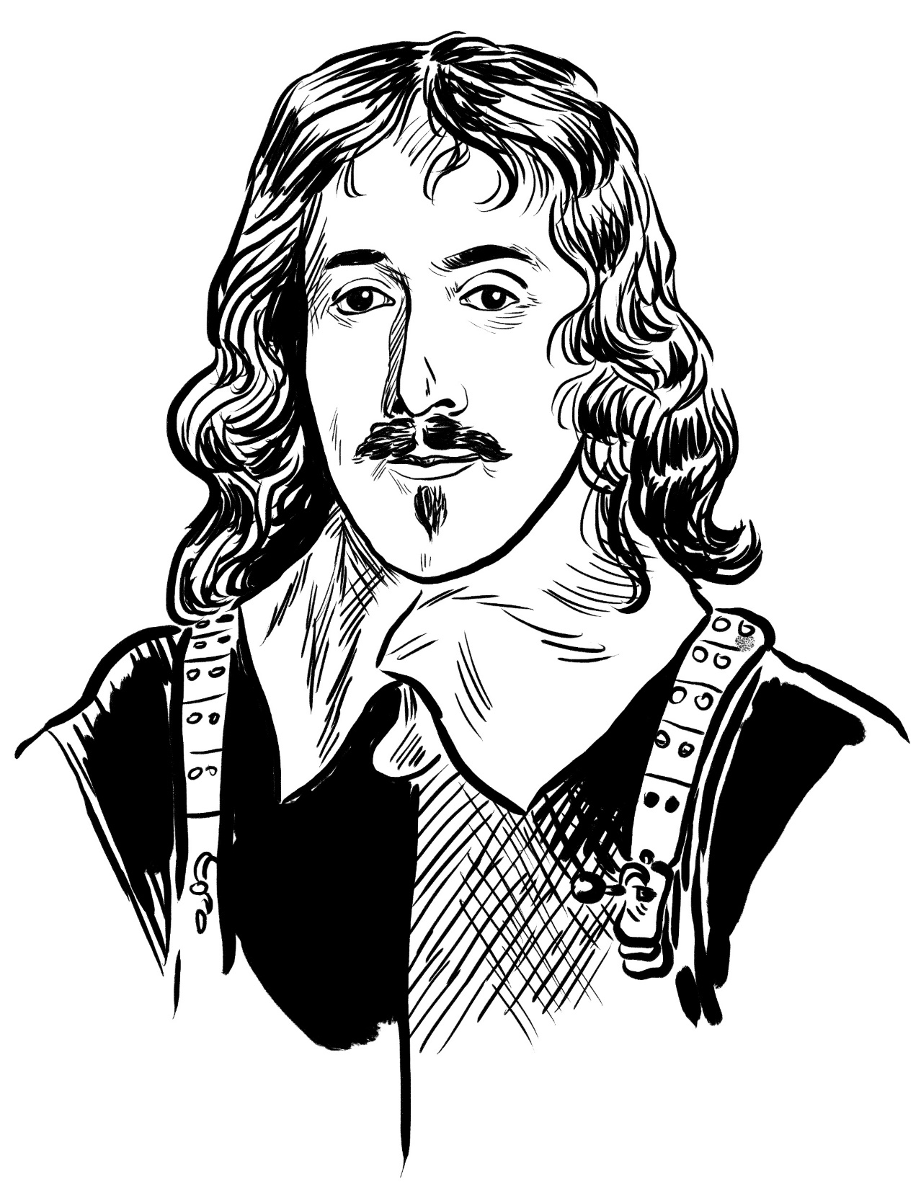
Denzil Holles
1st Baron Holles
1598-16801
A fiery speaker in Parliament.
Fought bravely at Edgehill in 1642.
Disliked Cromwell and once tried to have him tried in court.

Slide 23
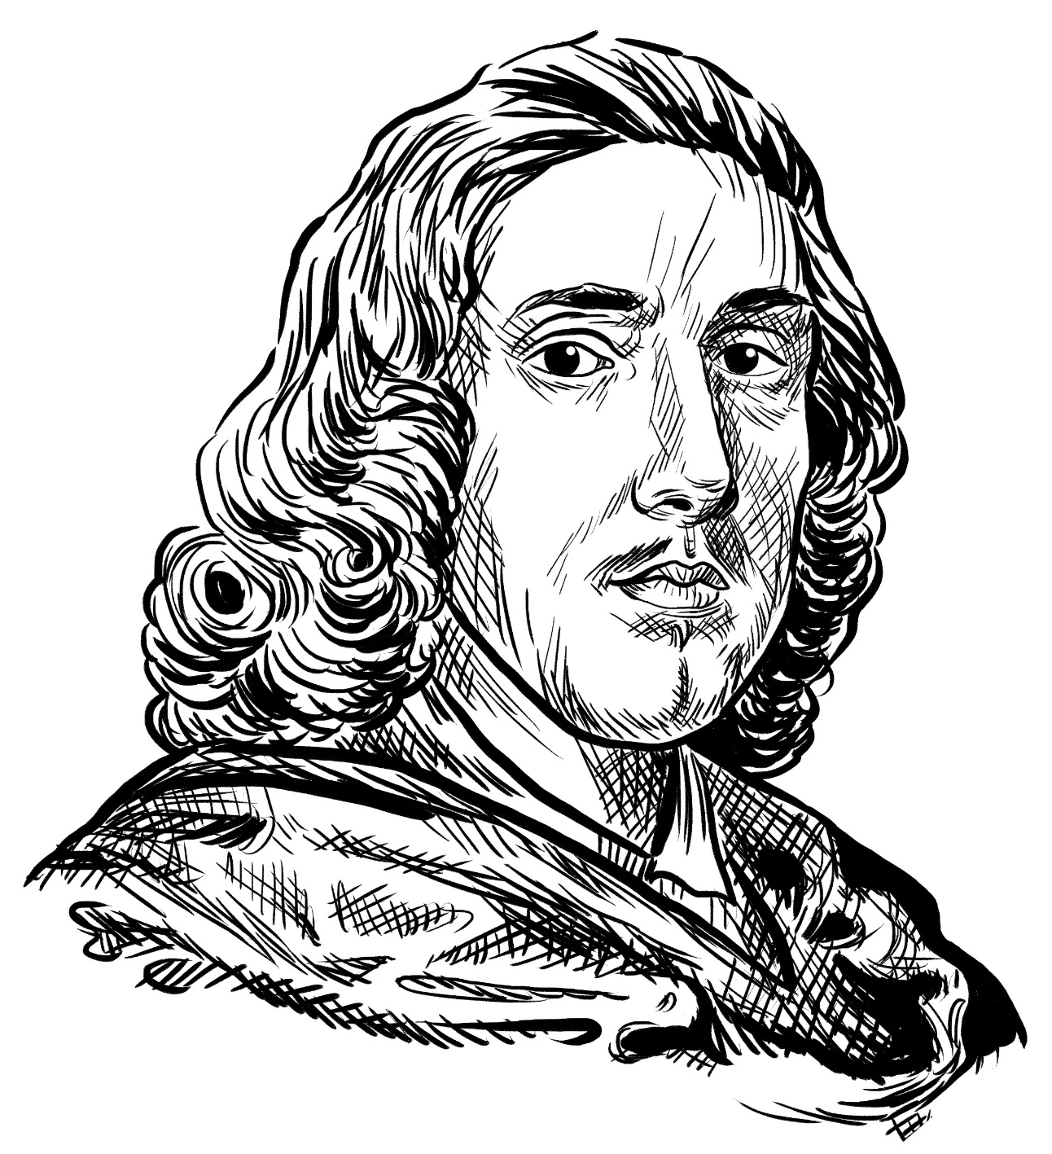
Sir Henry Vane the Younger
1613-1662
A Puritan who mistrusted the established church.
A negotiator and religious thinker.
He supported the creation of Cromwell’s New Model Army.

Slide 24
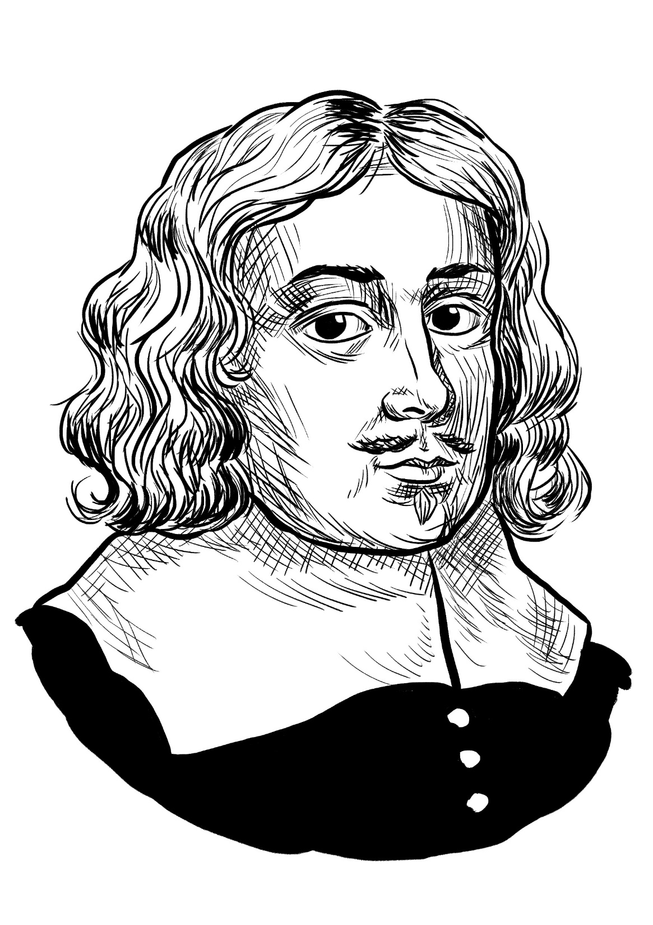
John Carew
1622-1660
One of 59 men who signed Charles I’s death warrant.
A member of the radical ‘Fifth Monarchists’, who saw the King’s defeat as the start of new religious age.

Slide 25
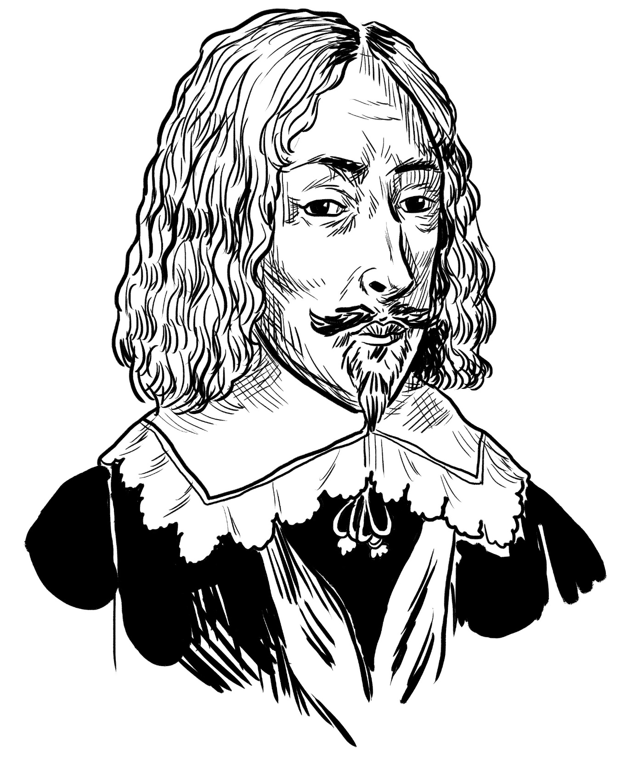
William Cecil
2nd Earl of Salisbury
1591-1668
A moderate Parliamentarian.
Owner of one of England’s largest mansions.
Did not play much of a role in the fighting.

Slide 26
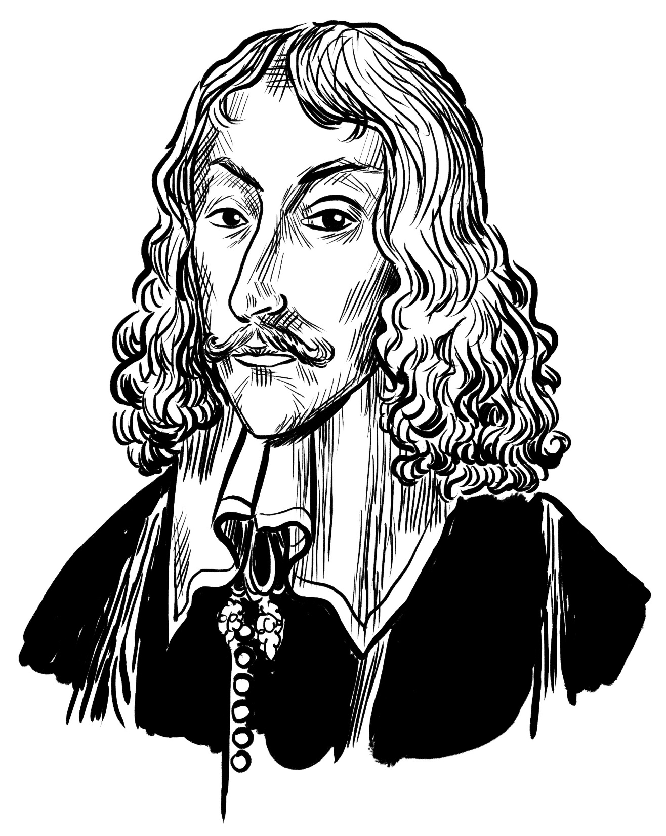
Basil Fielding
2nd Earl of Denbigh
c1608-1675
A foreign ambassador and a veteran of foreign wars.
At Uxbridge he privately declared that he regretted siding with Parliament.

Slide 27
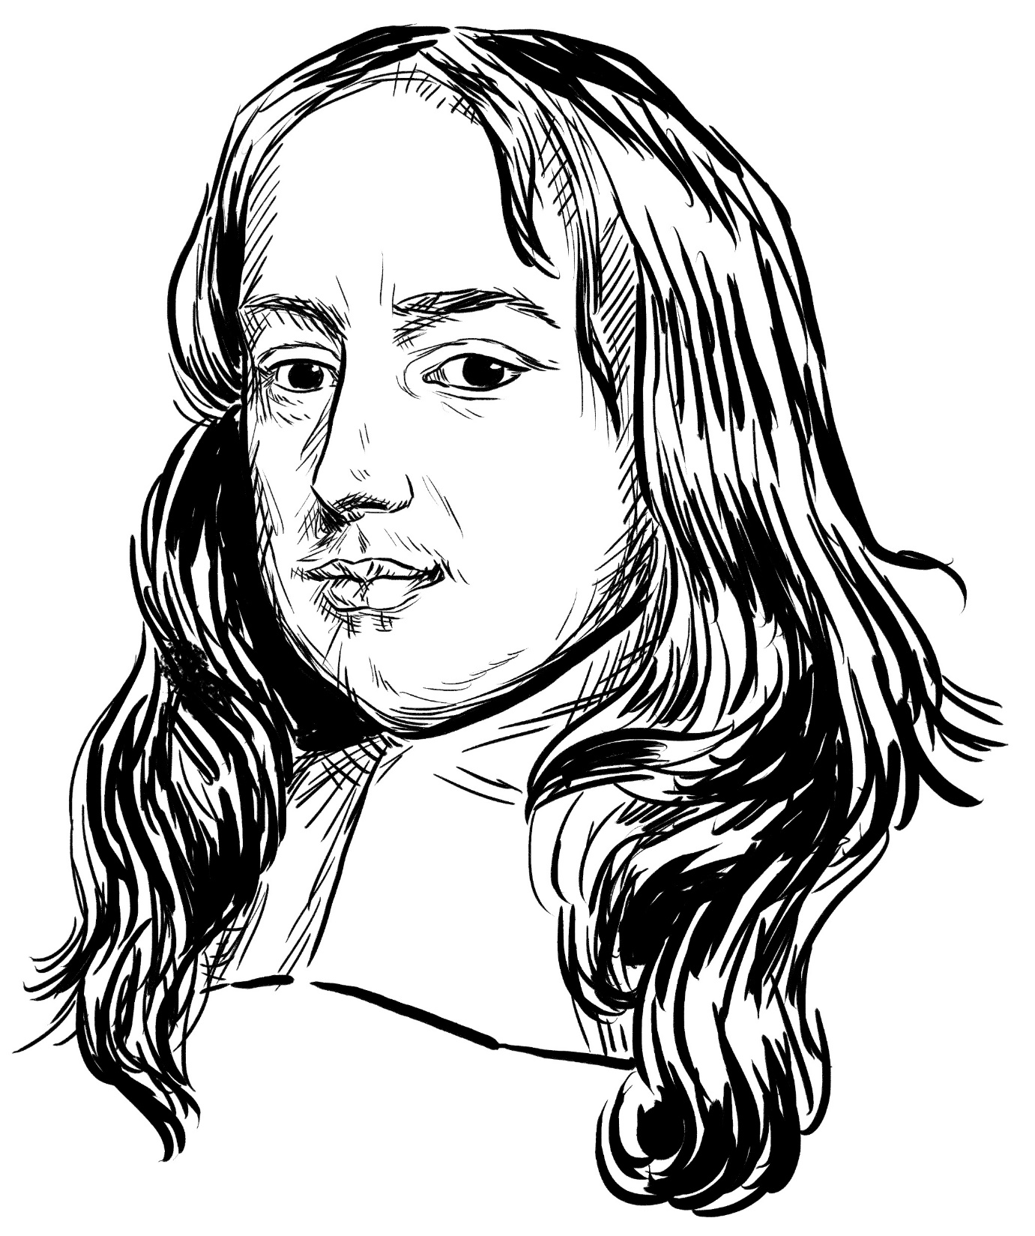
William Pierrepoint
1607-1678
A personal friend of Cromwell.
Supported a peaceful end to the conflict.

Slide 28
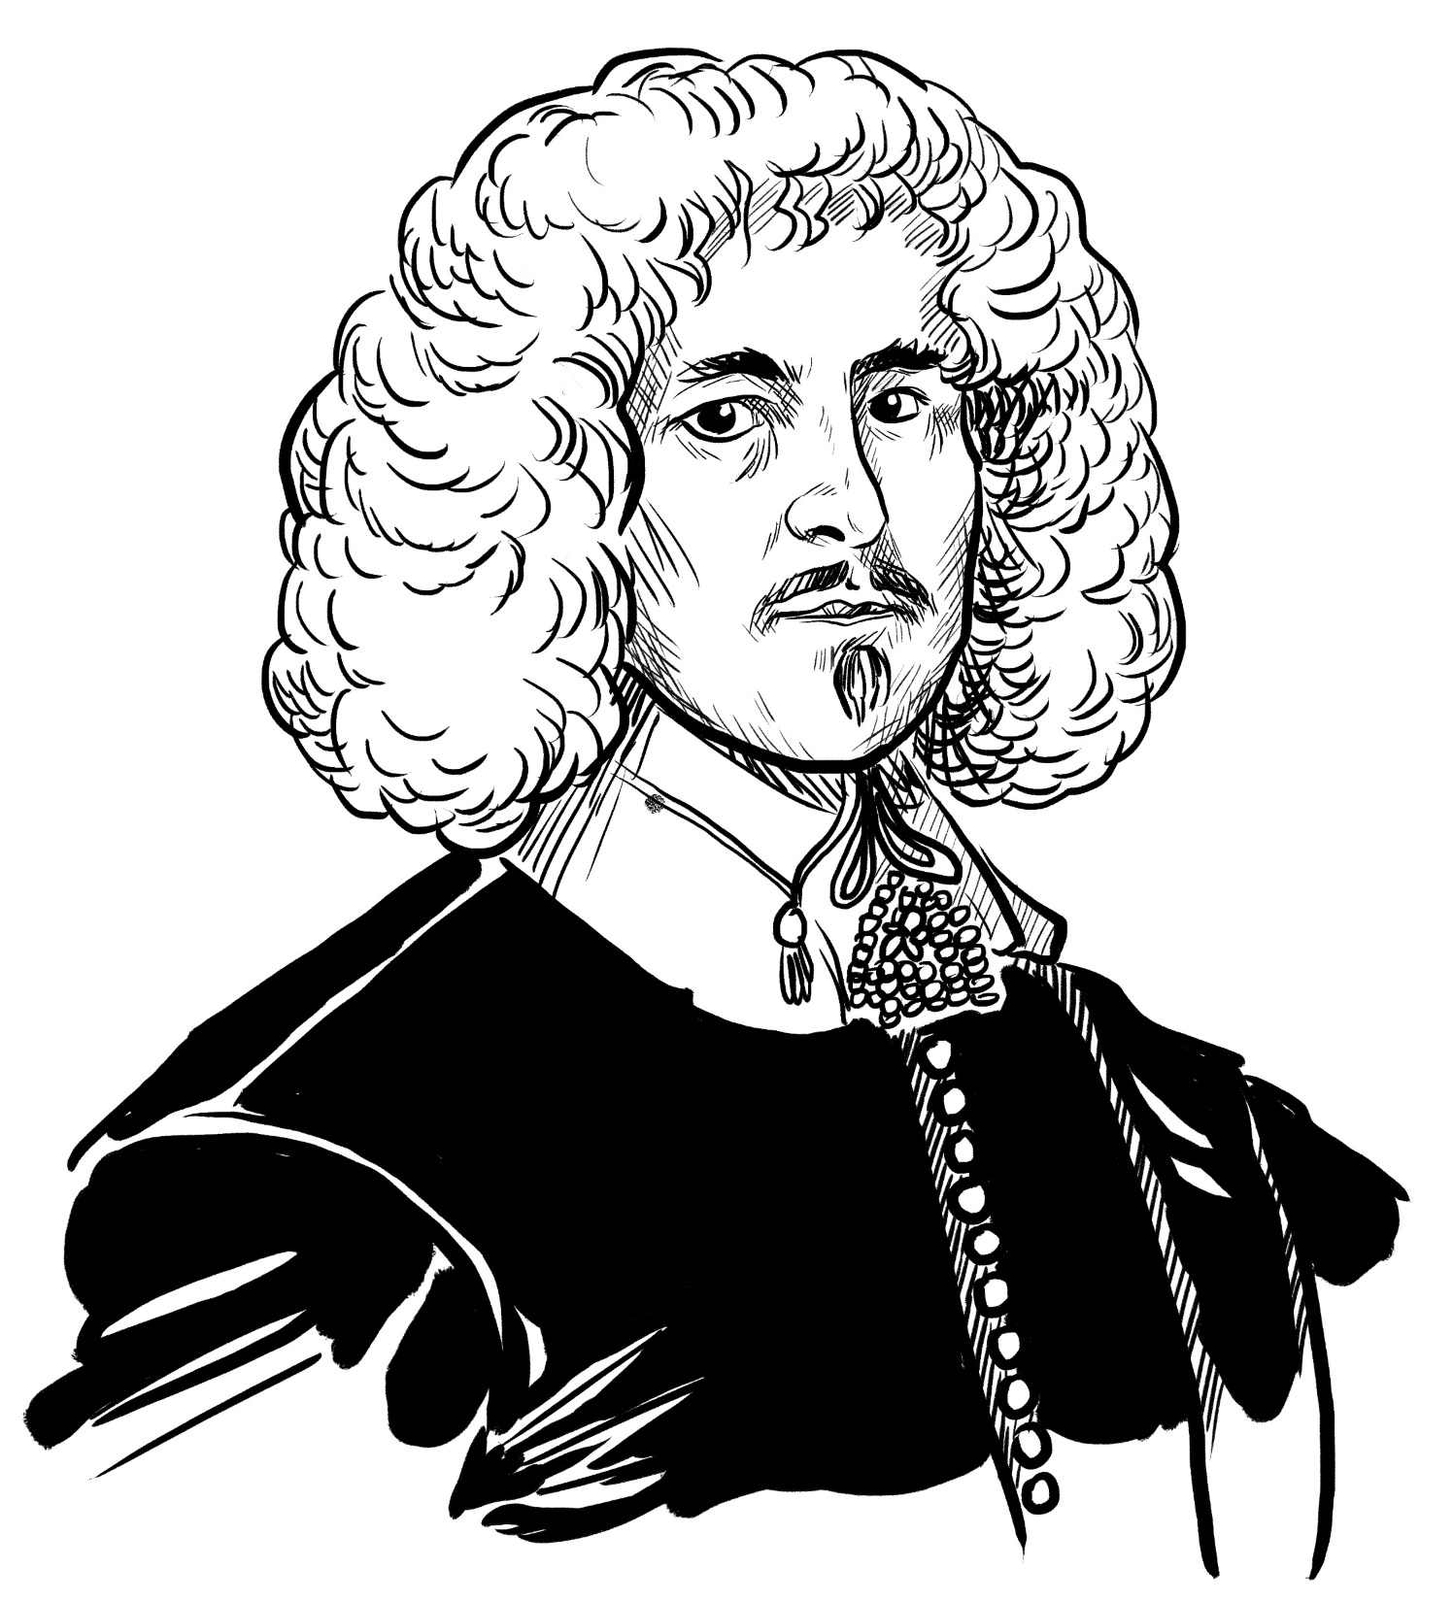
Oliver St John
1598-1673
A cold, forbidding character with few friends.
Later nicknamed the ‘Dark Lantern’.
A leader in the House of Commons.

Slide 29
Edmund Prideaux
d1659
A leading lawyer, but unwilling to compromise in negotiations.

Slide 30
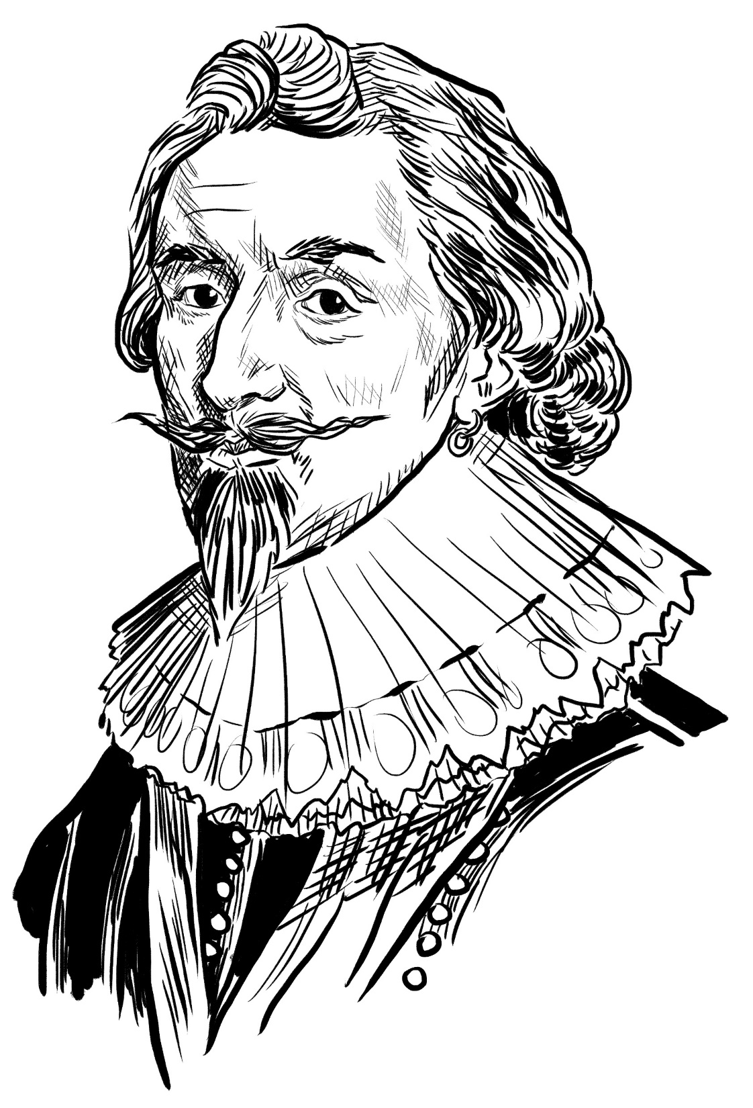
Philip Herbert
4th Earl of Pembroke
1584-1650
A regular negotiator for Parliament during the Civil Wars.
Held moderate views.
Was a friend to artists and writers.

Slide 31
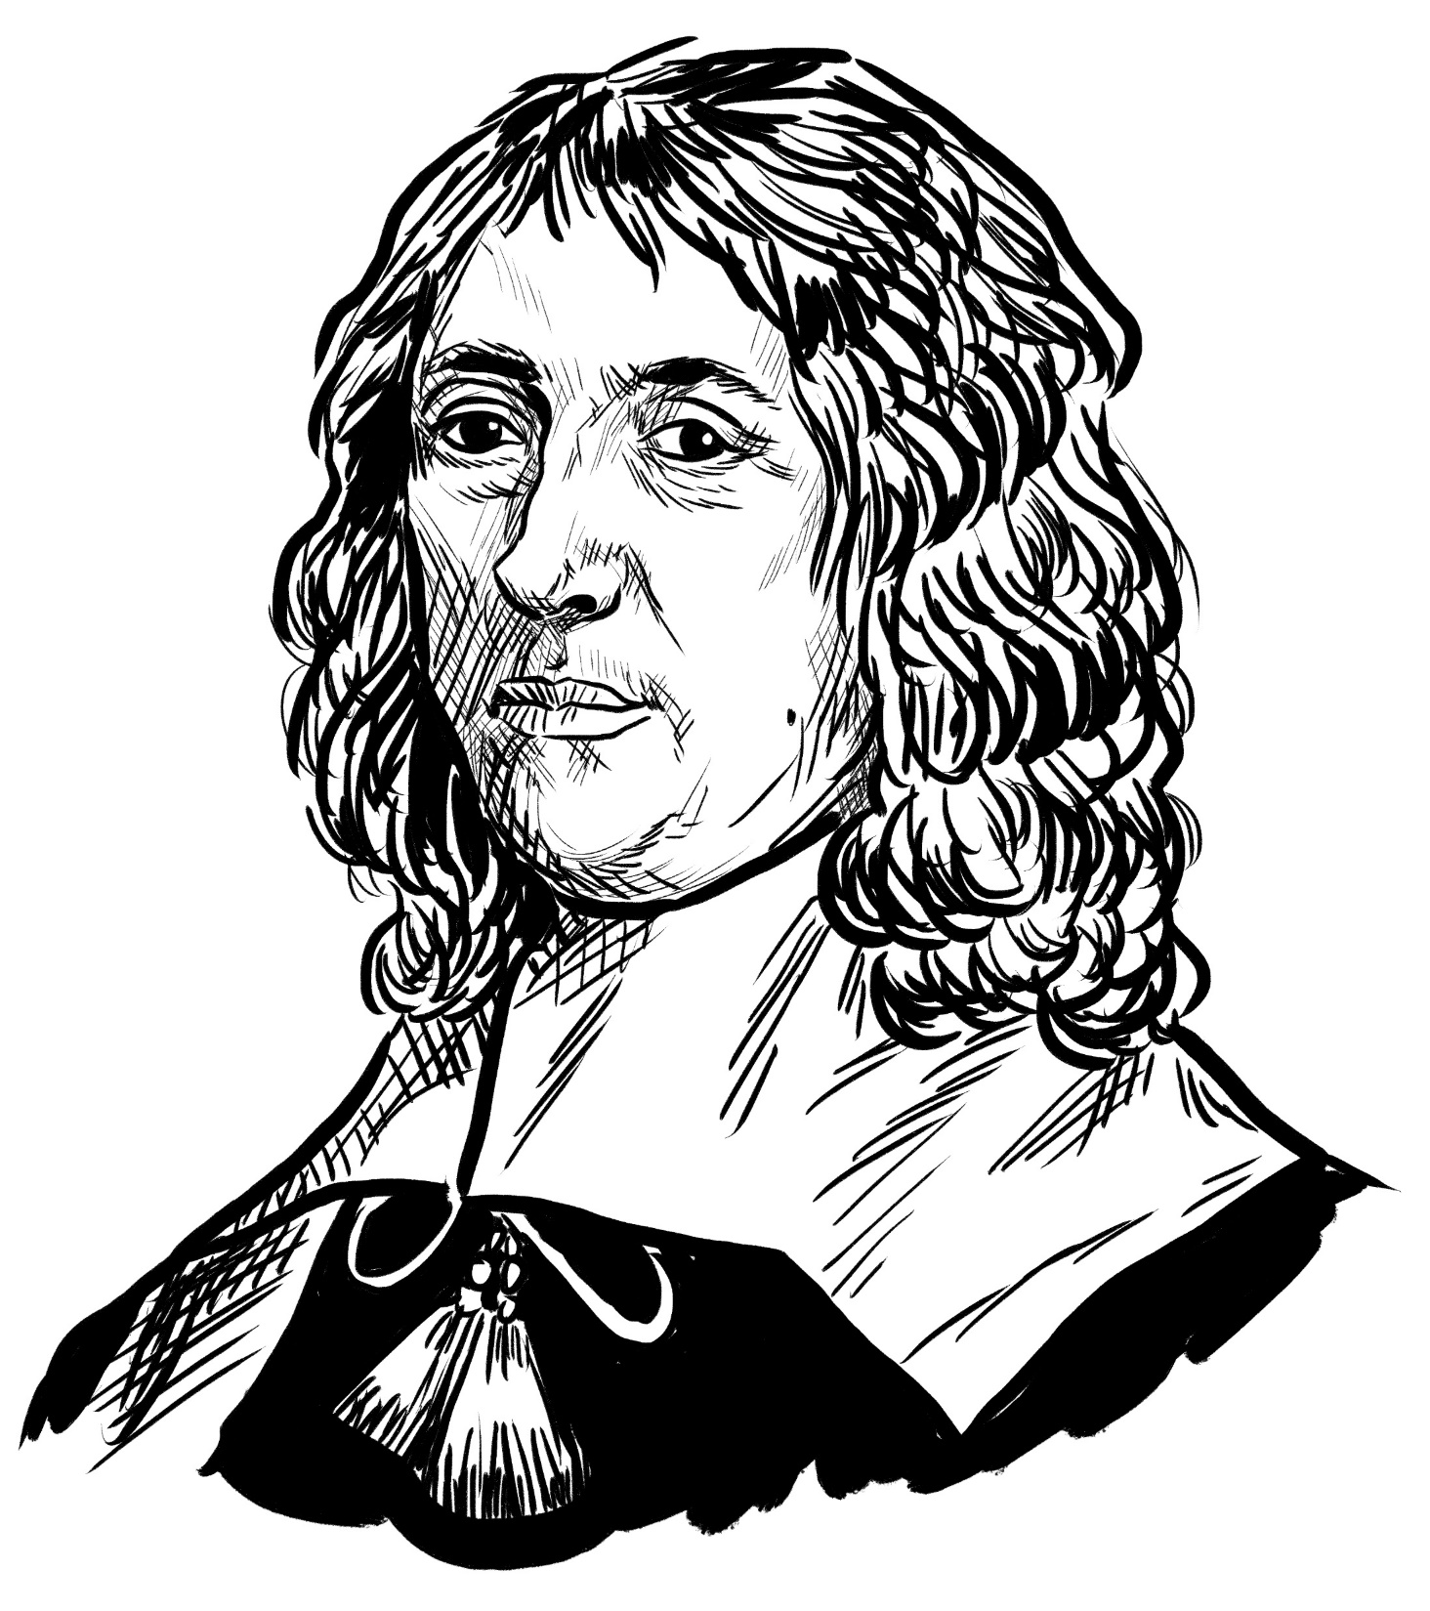
Thomas Wenman
2nd Viscount Wenman
1596-1665
Took part in all the main negotiations to end the Civil Wars.
Did not take an active role in the fighting.

Slide 32
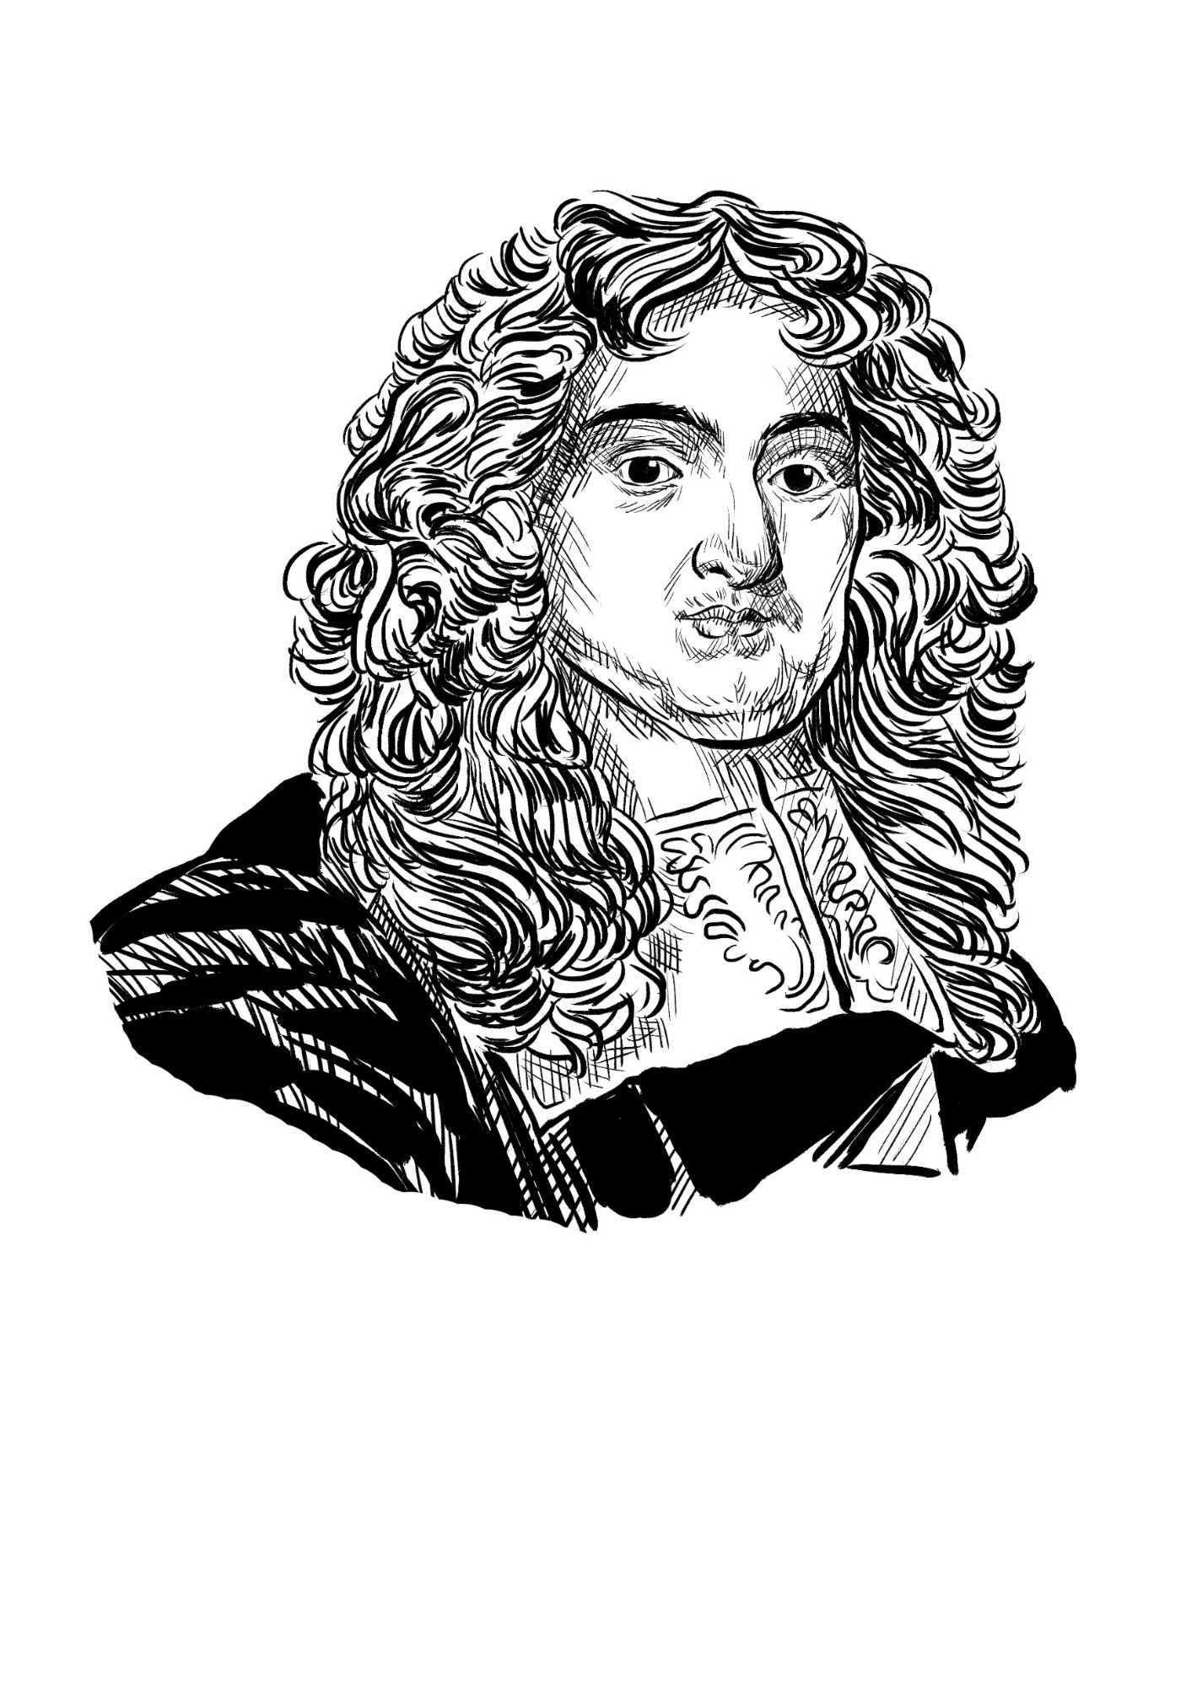
John Maitland
1st Duke of Lauderdale
1616-1682
Member of an ancient south Scottish family.
Crafty and ambitious.
Changed sides after the King’s surrender.

Slide 33
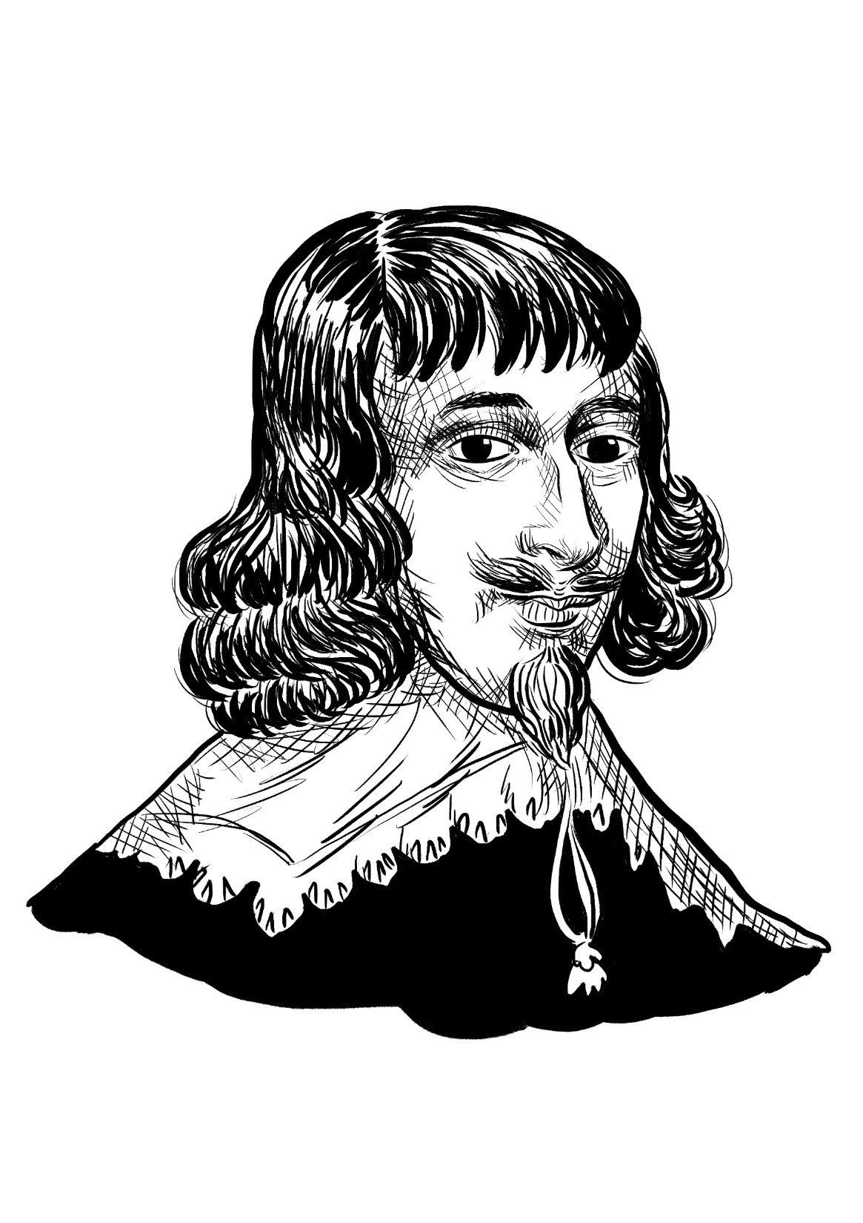
John Campbell
1st Earl of Loudoun
1598-1662
A leading Scottish official.
Had a history of negotiating with the King, though not always successfully.

Slide 34
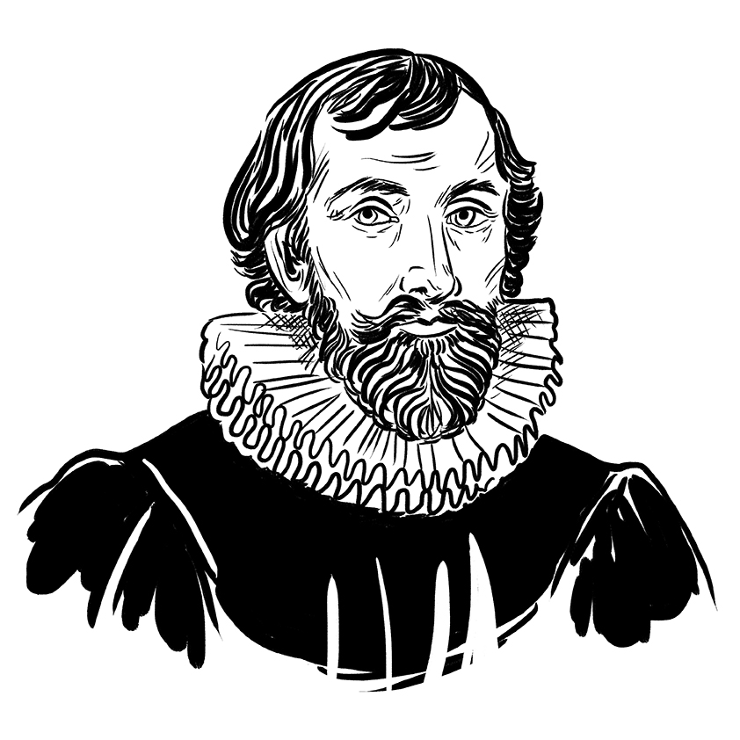
Alexander Henderson
1583-1646
One of Scotland’s leading churchmen.
He had a close relationship with the King, and was once priest to the royal children.

Slide 35
Archibald Campbell
1st Marquess of Argyll
1607-1661
An experienced politician.
Charming and persuasive.
Nicknamed ‘Red Argyll’ because of his red hair.

Slide 36
Parliamentarians
Royalists
Algernon Percy
10th Earl of
Northumberland
1602-1668
James Stewart
1st Duke of Richmond
1612-1655
Leader of the Parliamentary team.
From one of England’s oldest noble families.
Held moderate views and opposed the King’s execution.
Leader of the Royalist team.
A relative of the King, and very wealthy.
Skilled at bargaining and fighting. Defended Oxford for the King and led the Royalist negotiators at Uxbridge.

